Slide 1
Sustained Earnings and Revenue Growth, Earnings Quality, and Earnings Response Coefficients
Author: ALOKE GHOSH, ZHAOYANG GU, PREM C. JAIN
Presenter: Boying Liu

Slide 2
Introduction
In this paper, we explore the effects of sustained increases in earnings concurrent with sustained increases in revenues on the quality of earnings and earnings response coefficients (ERCs).
Sustained increases in earnings: increases in revenue vs. cost reductions.

Slide 3
Prediction
Background: Barth et al. (1999) show that ERCs (earnings response coefficients) are higher for firms reporting sustained increases in earnings than for other firms, suggesting that the growth in earnings is value relevant.
We predict that earnings growth supported by revenue growth is of higher quality than earnings growth supported by cost reductions.
We predict that earnings of firms with revenue-supported earnings growth have higher ERCs.

Slide 4
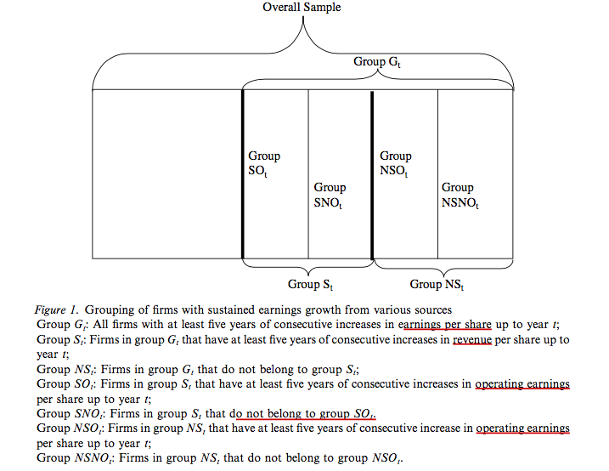
Research Design (Grouping of Firms)

Slide 5
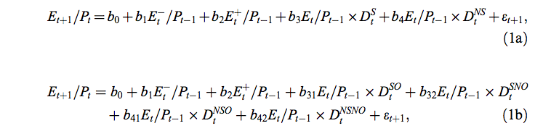
Model 1(a) 1(b) - “Level”
Model (1a) examines the two broad groups S and NS, and Model (1b)
examines the finer groups SO, SNO, NSO and NSNO.
“Model b” is a finer model compared to “Model a”

Slide 6
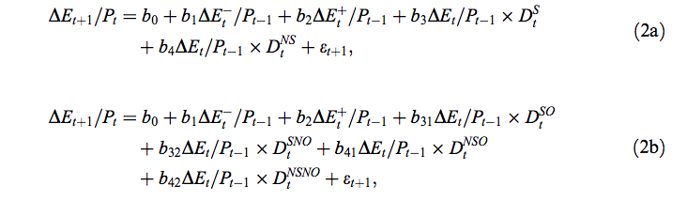
Model 2(a) 2(b) – “Growth”
Our second set of Models (2a) and (2b), directly examines the persistence
of earnings growth.

Slide 7
Coefficients for Model “1” and “2”
b1 and b2 capture the earnings persistence of negative and positive earnings/ earnings changes for average firms without sustained earnings growth.
Our interest is in the incremental earnings persistence parameters for firms that sustain earnings growth through various sources: bi, i >= 3.
For Models (1a) and (2a) (groups S vs NS), expect b3 >b4 >0. That is, the incremental persistence parameters are higher when earnings growth is sustained through revenue increases.
For Models (1b) and (2b) where both revenues and operating earnings are considered, we expect b31 > b41 > 0 and b32 > b42 > 0. That is, within firms with sustained operating earnings increases (SO and NSO) and those without (SNO and NSNO), the incremental earnings persistence parameters are higher when firms have revenue-supported earnings growth. We also expect b31 > b32 > 0 and b41 > b42 > 0.

Slide 8
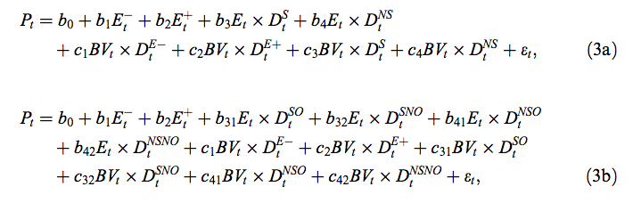
Model 3(a) 3(b) – Price Level
where BV is book value per share and D^E- and D^E+ are dummy variables for
E < 0 and E >= 0. We measure stock prices Pt three months after the end of
fiscal year t to ensure that accounting information is available to the
market for valuation purposes.

Slide 9
Model 3(a) 3(b) – Price Level
Higher weight on earnings corresponds to a lower weight on book value. (Ohlson)
Empirical studies show that the relative weight on book value is low (high) when earnings levels are high (low).

Slide 10
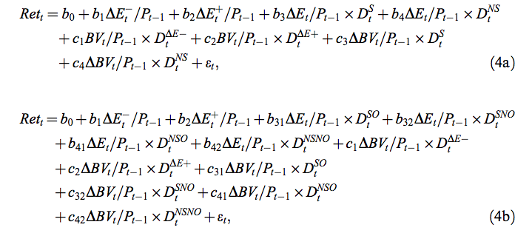
Model 4(a) 4(b) - Return
where “Ret” is the compounded stock return from the fourth month of fiscal year
t to the third month after the year-end, and D^deltaE- and D^deltaE+ are dummy
variables for Delta E < 0 and Delta E >= 0.

Slide 11
Coefficients
Similar to the prediction for Model (1a), our prediction for Models (3a) and (4a) is b3 > b4 > 0.
That is, ERCs are higher when earnings growth is sustained through revenue increases than through cost reductions.
Similar to the prediction for Model (1b), our prediction for Models (3b) and (4b) is b31 > b41 > 0 and b32 > b42 > 0.
That is, for the groups with sustained operating earnings increases and the groups without these increases,
ERCs are always higher when earnings growth and revenue growth are sustained concurrently.
We also predict b31 > b32 > 0 and b41 > b42 > 0.

Slide 12
Data Selection
A firm is included only if it has at least five consecutive years of accounting data.
To mitigate the potential effect of outliers, we remove the top and bottom 1% of observations for stock prices, book value and earnings.

Slide 13
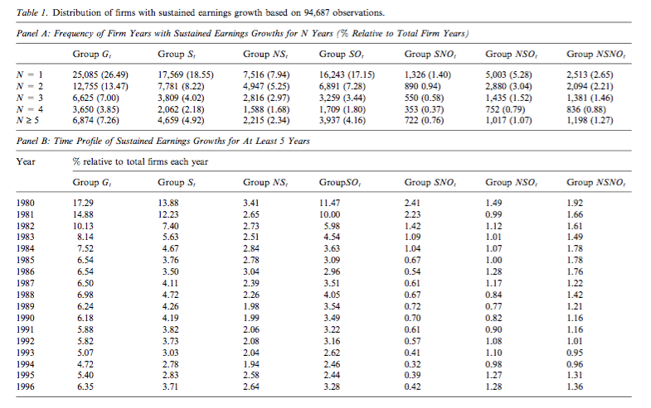
Descriptive Statistics

Slide 14
Descriptive Statistics
In Panel A, the frequency and percentage (relative to total firm years) of firm years with varying lengths of earnings increases are reported.
In Panel B, firms with long strings of growth in earnings are more prevalent in the first couple of years in our sample period.

Slide 15
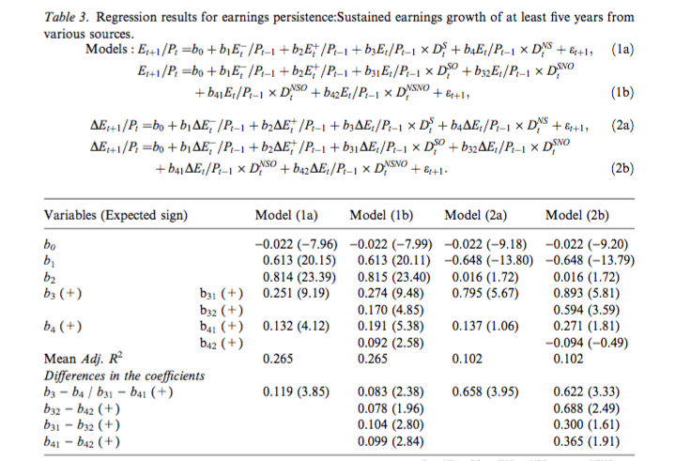
Results

Slide 16
Results
Recall: Model (1a) examines the difference in persistence of earnings levels across groups S and NS.
Model (1a): For firms without sustained earnings growth, the persistence parameter is b1 = 0.613 (t = 20.15) for negative earnings and b2 = 0.814 (t = 23.39) for positive earnings. The incremental persistence parameter is b3 = 0.251 for group S and b4 = 0.132 for group NS, both highly significant (t > 4).
The parameters suggest that 1% of current ROEs is able to predict about 1.065% (0.814 + 0.251) of future ROE for firms in group S and 0.946% (0.814 + 0.132) for firms in group NS. The difference between the two is highly significant (b3-b4 = 0.119%, t =3.85).

Slide 17
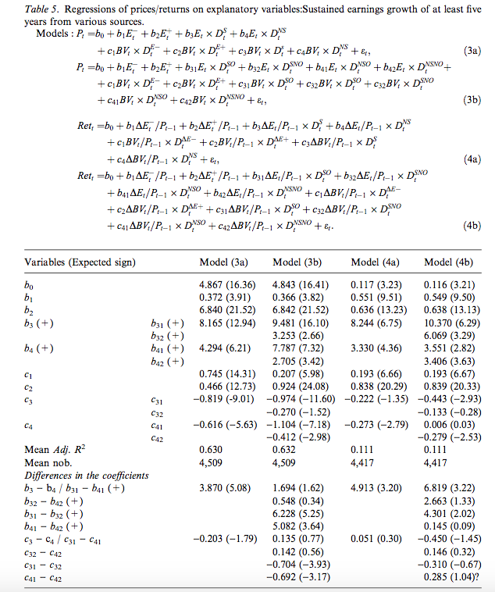
Results

Slide 18
Results
The ERC on positive earnings is much higher than that on negative earnings (b2 = 6.840 > b1 = 0.372). The corresponding BVRCs differ in the opposite direction (c2 = 0.466 < c1 = 0.745). (This is consistent with Collins et al.’s (1998) argument that the valuation role of book value is important when earnings are negative.)
Overall, the results suggest that as firms’ growth becomes more sustainable, the valuation weight on earnings becomes larger and the valuation weight on book value becomes smaller or even negative. (b3,b4,c1-c4)

Slide 19
Conclusion
We hypothesize that earnings are of higher quality when growth in earnings is supported by revenue increases rather than through cost reductions.
Revenue-supported earnings growth is likely to be more sustainable because revenue is the key value driver and its growth often reflects the underlying product differentiation strategy (Porter, 1980, 1985).
Unlike cost reductions that are often reactive and have a lower bound, revenue increases are proactive with unlimited potential.
Our results are consistent with the predictions.

