Slide 1
On the Relative Pricing of Long-Maturity Index Options and Collateralized Debt Obligations
PIERRE COLLIN-DUFRESNE
ROBERT S. GOLDSTEIN
FAN YANG
The Journal of Finance, Dec 2012

Slide 2
Overview
Jointly price long-dated S&P 500 index options and CDO tranches of corporate debt.
Investigate a structural model of market and firm-level dynamics.
Index option -> Market dynamics
Term structure of credit spreads -> Idiosyncratic dynamics
Empirical results:
Before crisis, all tranches can be well-priced out-of-sample
After crisis, senior tranche price can be captured with jump
Therefore, senior tranche provide information on catastrophic risk and no mispricing according to the model.

Slide 3
Reasons for Writing the Paper
Widely known underestimation of risk in subprime mortgages but Less well-known the dramatic decline across major asset classes
It’s difficult to price as default events are rare for major assets in the past
Q:
Whether there was significant flaw in CDO pricing methodology?
In 2009, "Recipe for Disaster: The Formula That Killed Wall Street," Wired Magazine blame for the use of Vasicek model

Slide 4
Previous Work
Co val, Jurek, and Stafford (CJS (2009)) investigate CDO from IG Corp Bond
Derive from 5-yr index options across multiple strikes
Systematic: Firm-level Beta + Market Dynamics
Idiosyncratic: Calibrate volatility to equity returns + Norm. Dist
Company default at maturity if fall below Merton Structural Model threshold
Findings: Senior tranches credit spreads too low whereas junior credit spreads too high.
Systematic risk has been ignored in pricing.
"preferred" stochastic volatility diffusion model (SVCJ) of Chernov, and Johannes (BCJ(2007))

Slide 5
Improvements
Introduce dynamic structural model of default for each firm in the portfolio
Applied to multiple maturities (Calibrate on entire term structure of CDX)
Why short-term CDX calibration important?
1. Default timing information is incorporated which impacts equity tranche significantly
2. Idiosyncratic component
3. Jump should be considered for short-term (Otherwise, too much shift to tail)
4. CDX compose total risk

Slide 6
Improvements
Default occurs at the time the value fall below threshold
A relative pricing across the stock option and CDO markets and pricing CDO tranches out-of-sample
Two stochastic volatility processes in modeling the process
(Additional freedom to calibrate on both long-term and short-term)

Slide 7
Model Specification
A. Market Dynamics for Pricing S&P 500 Options
Standard affine model with two stochastic volatility processes
Common method: Local volatility model + traded options
Difficulties:
To study super-senior tranche, far extrapolation is required
Solution: Joint-Markov affine jump diffusion process
Consistent with extrapolation and from economically motivated dynamics
State price density surface can be acquired once calibrated

Slide 8
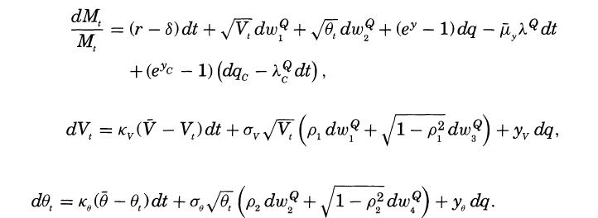
Model Specification
A. Market Dynamics for Pricing S&P 500 Options
$$Note “Catastrophy” is not$$
$$observed on market options,$$
$$but can be found in super−senior tranches$$
$$dq is a jump process with constant jump intensity λ^{Q},$$
$${dq}_{c} captures catastrophic jump$$
$$Variance State$$
$$Variables$$
$$The compensator for the jump in the market price:$$

Slide 9
Model Specification
A. Market Dynamics for Pricing S&P 500 Options
Applying FFT(Fast Fourier Transformation)
$m_{t}=logM_{t}$ log index return process

Slide 10
Model Specification
B. Firm Dynamics and Structural Default Model
Individual firm dynamics
Regression on unlevered Asset Value vs. levered mkt return
Payout Ratio
Systematic Jump
Idiosyncratic Jump

Slide 11
Model Specification
B. Firm Dynamics and Structural Default Model
Again, default arrival time is defined as
Further define loss rate $l$ and recover value upon default is $\left(1−l\right)A_{B}$
$A_{B}$ is defined by Black and Cox(1976)

Slide 12
Model Specification
C. Basket CDS Index – Synthetic CDO Tranches (CDX)
The protection buyer makes payments (sometimes upfront) until the maturity of the contract, or until one of the constituents experiences a default event. In the latter case, the protection buyer delivers a defaulted bond for the notional amount in the index to the protection seller in return for the notional (1/125 of the index notional) of the bond in the index.
Assume 0 upfront payment

Slide 13
Model Specification
C. Basket CDS Index – Synthetic CDO Tranches (CDX)
Index protection seller value (premium):
Index protection buyer value:
Time Fraction
Accrued

Slide 14
Model Specification
D. CDO Tranche Spreads
CDX.IG have 6 CDO tranches and attachment points are :
0-3% Equity tranche; 3-7% (mezzanine);
7-10%, 10-15%, and 15-30% (senior); and 30-100% (super senior)
The buyer of protection tranche pays premium corresponding to the remaining tranche notional times the tranche spread until maturity

Slide 15
Model Specification
D. CDO Tranche Spreads
Tranche($j$) loss as a function of cumulative loss ($L_{t}$),$K_{j}$is the cum coverage
Protection Buyer value:

Slide 16
Model Specification
D. CDO Tranche Spreads
Protection Seller value (Tranche, except for equity and super-senior):
Equity tranche(upfront prem. U + 500bps):
Super-senior tranche
Remainder
Less sensitive to timing
Recovery

Slide 17
Model Specification
D. CDO Tranche Spreads
Timing sensitivity
Quarterly payment drops from $(0.03) (\frac{S}{4})$before any defaults to $(0.03 –\frac{1−R}{125})(\frac{S}{4})$after the first default. For a standard recovery rate of R = 0.4, this is approximately a 16% decrease in payments.

Slide 18
Data (Simplified)
Primary: (Range :2004.09 – 2008.09)
European Option Implied Vol 1- and 5-year and moneyness 0.5-1.5
CDX.IG 1-5yr and tranche spread 3- and 5-year maturities
Note that on-the-run CDX series (different maturities) are introduced every 6 months
Synthetic CDO tranches based on Dow Jones CDX North American IG Index
Unfunded, levered, liquid

Slide 19
Calibration
First, calibrate market return parameters and state variable $(V, θ)$
(data from OTC long- and short-dated European option prices)
Second, calibrate firm-specific parameters using firm-specific information
(data from CRSP, Compustat and credit spread information)
Assume homogeneity for benchmark calibration
Pre-crisis catastrophic jump intensities are close to 0

Slide 20
Calibration
Persistent- Long-term
Jump size and intensity

Slide 21
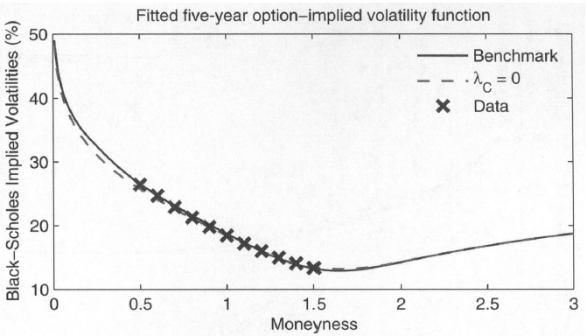
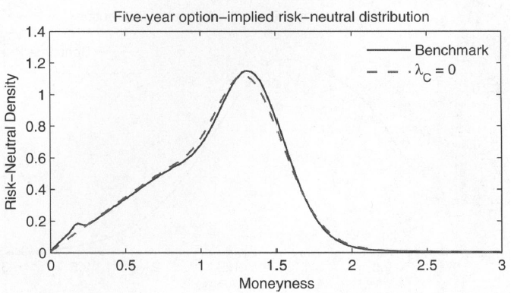
Calibration
Pre-crisis(06/15/2005)

Slide 22
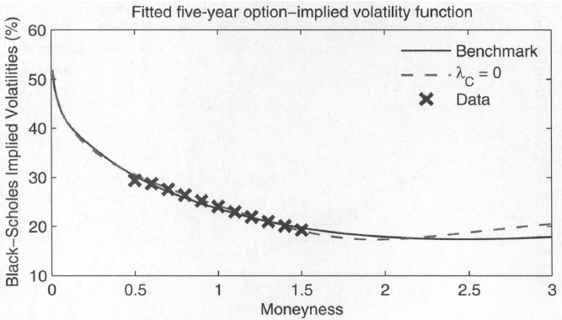
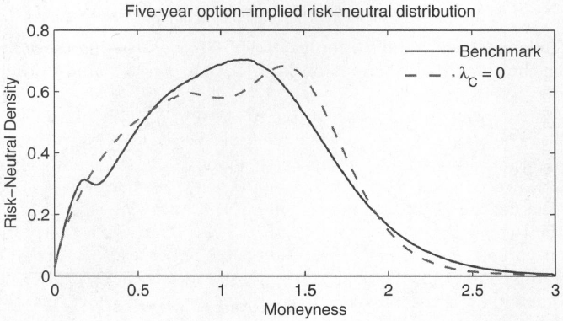
Calibration
During crisis(05/21/2008) (Divergence on distribution)

Slide 23
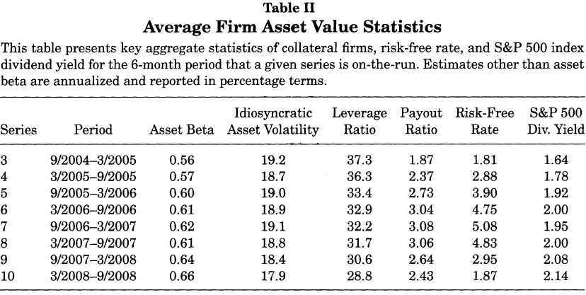
Calibration
Firm Value Dynamics (Set $A_{B}=$ $60\%∗ LR, R_{n}=40\%, R_{c}=20\%, y_{i}=−2.0)$
Sys vs. Idio
Fatter tail

Slide 24
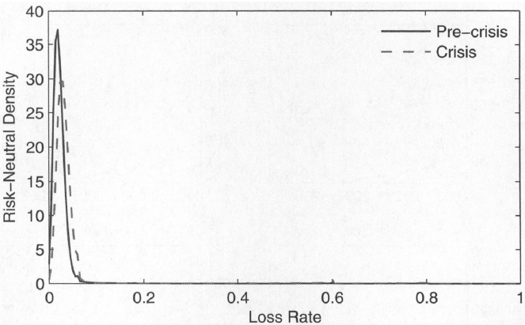
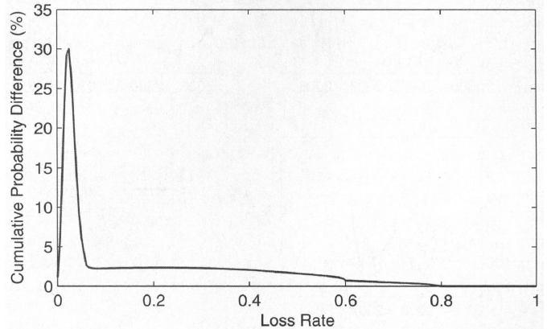
Calibration
Crisis - Pre
Fatter tail

Slide 25
Calibration
Jump is essential here. Well-documented failure of structural model calibrating on short-term investment grade credit spread.

Slide 26
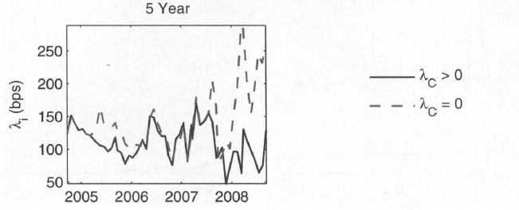
Calibration

Slide 27
Result
A. Average Tranches Spread

Slide 28
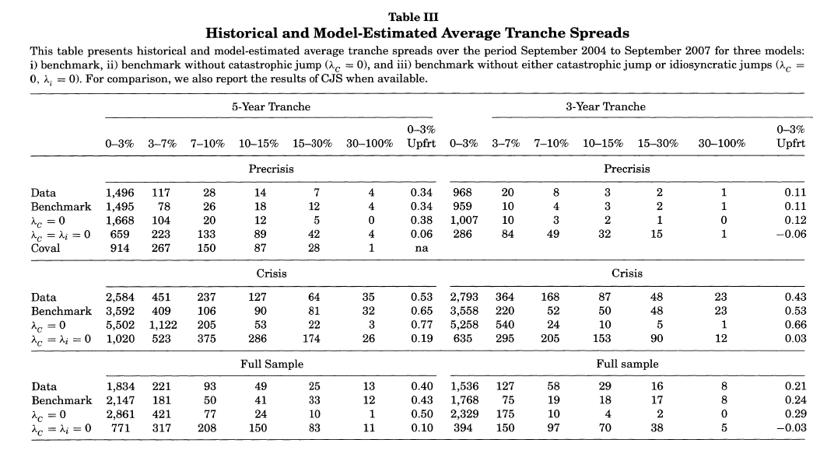
Result
Close
Unusual short-term jump

Slide 29
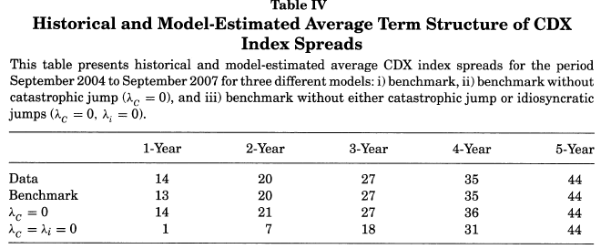
Result
Underestimation in short-term.
Expected losses are "backloaded" in this model, implying that the buyer of equity protection pays too much premium for too long, in turn, biasing down the estimate for the equity tranche spread.
Calibrate to 5-year

Slide 30
Result
To estimate tranche spreads, the model has to be calibrated to match the term structure of credit spreads.
The timing of defaults is backloaded when idiosyncratic dynamics driven only by diffusive risk causing low spreads and risk-neutral expected losses at short maturities.
During the crisis, quoted option prices do not contain enough information about the very deep out-of-the-money state prices which are crucial for the pricing of super-senior tranches (needs extrapolate). However, spreads on other tranches can be interpolated well given option prices and super-senior tranche spreads.

Slide 31
Result
B. Time Series of Tranche Spread

Slide 32
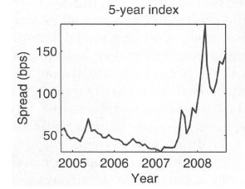
Result
Historic Index
(Perfect Cali.)

Slide 33
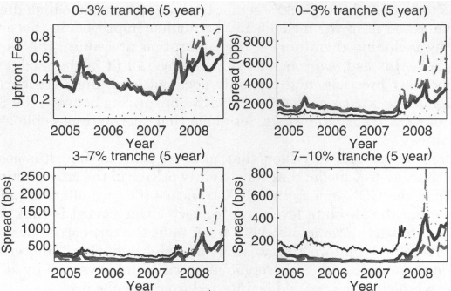
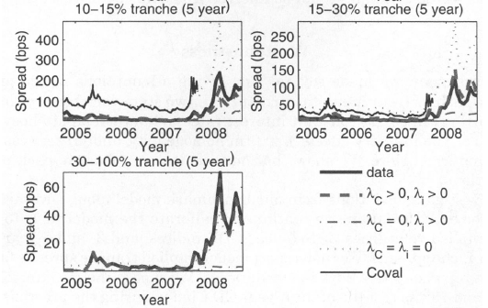
Result
5-year index, different tranches
Too high
Too low

Slide 34
Result
It is the fitting of the term structure of CDS spreads that generates our ability to match the data better.
The super-senior tranche is not a redundant security in that it provides window into the market's crash-risk expectation and risk-aversion.
No implication for significant mispricing (regarding no-arbitrage) before and during crisis of CDO tranches (Option and CDO market are integrated)

Slide 35
Further Improvements
The fit could be improved to calibrate market and firm dynamics by including information from other, say mezzanine, tranche spreads in calibration, rather than pricing them out-of-sample.
To study an extension where the term structures of idiosyncratic and catastrophic jump risks are governed by stochastic processes whose dynamics could be inferred from tranche prices.

Slide 36
Robustness
Implied volatility of fitted state variables tracks the VIX fairly closely.

Slide 37
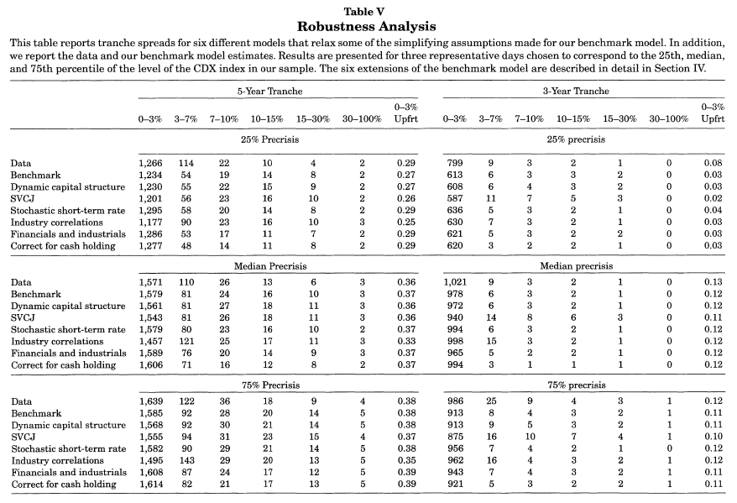
Robustness

