Slide 1
Networking as a Barrier to Entry and the Competitive Supply of Venture Capital
Author: YAEL V. Hochberg, Alexander ljungvist, and yang lu
Presenter: Spike

Slide 2
Agenda
Introduction of This Topic
Summary of The Research
Personal Insights

Slide 3
OFO
The world leader in station-free bike sharing
Founded in 2014 and based in Beijing, China, ofo is the world's first and largest station-free bike sharing platform. ofo is committed to providing the best short distance transportation solution, solving the “last mile” transportation problem by turning the last mile into a green, low-emission trip. To date, ofo has connected more than 8M bikes to over 100M users, in 8 countries and 170+ cities around the world.

Slide 4
Open Question?
Suppose we are at the beginning of 2014 and everyone here is a private investor whom has a $1Mn commitment. Dai Wei, the CEO of OFO, asks you to invest $1Mn for 20% of OFO’s equity share(Seed Round) as the company has been financially drained and obligated with a 6Mn RMB loan due in the next 24 months. Would you make this investment?
Reference:
Series D round: $450 Mns announced in March, 2017
Series E round: $700+ Mns announced in July, 2017
Series E Led by: Alibaba, Hony Capital, Citic PE
This story is fictional. Any resemblances to any organization or persons is purely coincidental.

Slide 5
1. Introduction
1.1 Barriers
1.2 Arguments
1.3 Structure
1.4 Results

Slide 6
1.1 Barriers
Visible barrier: Regulatory
Invisible barrier: Incumbents’ advantage in local market
Entrants’ strategy to eliminate the barrier: Reciprocity
Incumbents’ strategy to keep the barrier: Punishment

Slide 7
1.2 Arguments
Whether strong networks among incumbent venture capitalists in local markets help restrict entry by outside VCs?
Whether the restriction improves incumbents’ bargaining power over entrepreneurs?

Slide 8
1.3 Structure
Test Whether the networking patterns in the data are exogenous
Find determinants of an individual VC firm’s entry decision
Measure the cost of deviation (punishment)
Exam the price effect of reduced entry

Slide 9
1.4 Results
Incumbents engage in strategic behavior that reduces entry
A one-standard deviation increase in the extent to which incumbents are networked reduces the number of entrants by 1/3.
Incumbents benefit from doing so through paying lower price for their investment
A one-standard deviation increase in the networking measures is associated with a 10% decrease in valuation, from the mean of $25.6 Mns.

Slide 10
2. Summary
2.1 Market level analysis
2.2 Firm level analysis
2.3 Punishment
2.4 Valuation effects
2.5 Alternative explanations

Slide 11
2.1 Market level analysis
Data
Thomson Financial’s Venture Economics database
All investments in U.S. companies made by U.S. based VC funds between 1975 and 2003.
Exclusion: Angels and Buyout funds

Slide 12
2.1 Market level analysis
Market Definition
State Market
Usually cover larger geographic areas, resulting in a broader market definition
Metropolitan Statistical Area
Usefully aggregate economic activity across borders, where appropriate

Slide 13
2.1 Market level analysis
VCs
Incumbents
VC firms that have invested in the target market at some time prior to year t and continue to have investments in the market as of year t.
Entrants
VC firms that invest in the market for the first time in year t. They are themselves incumbents in other markets.

Slide 14
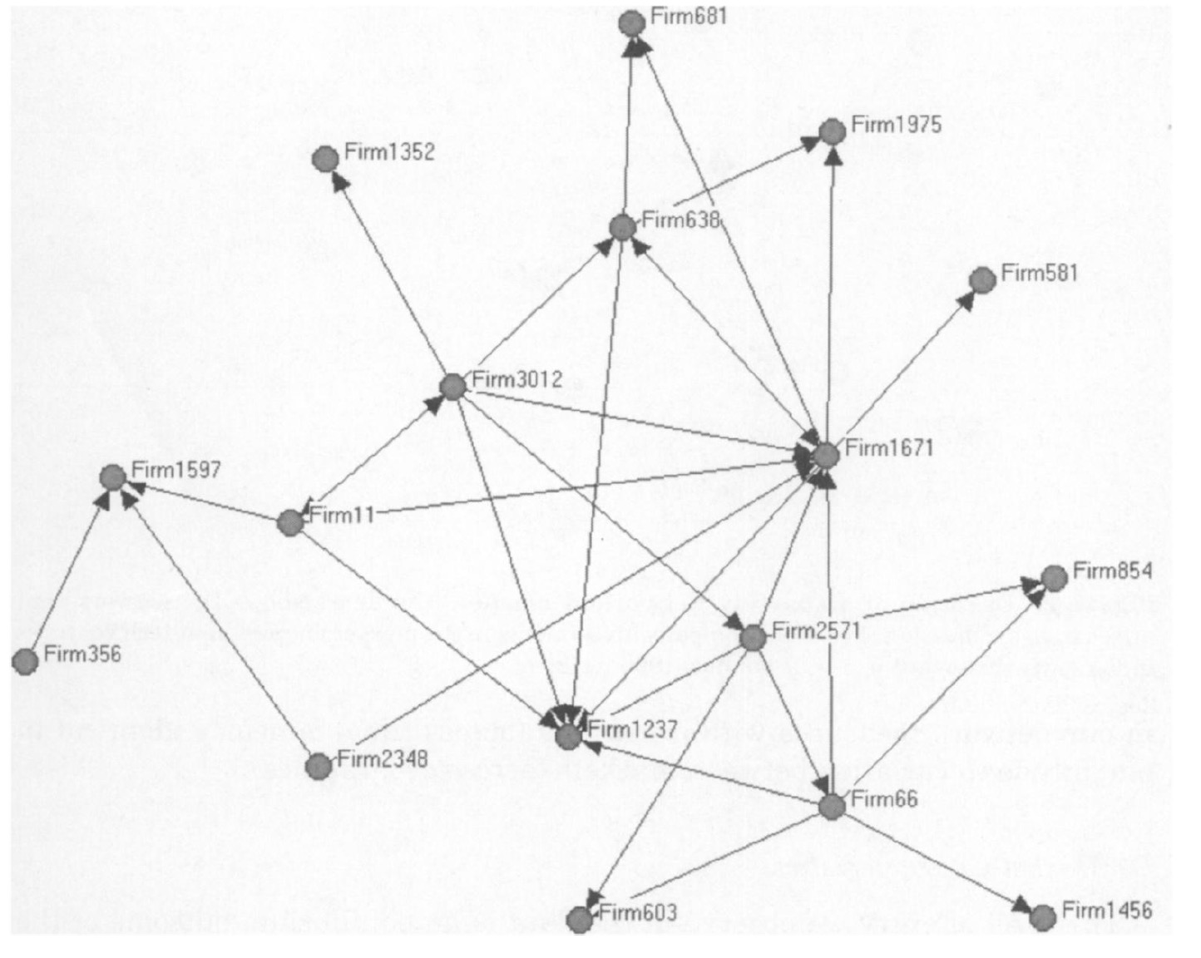
2.1 Market level analysis
Dense syndication network
Computer-related ventures in Michigan over the 5-year-window 1979 to 1983.

Slide 15
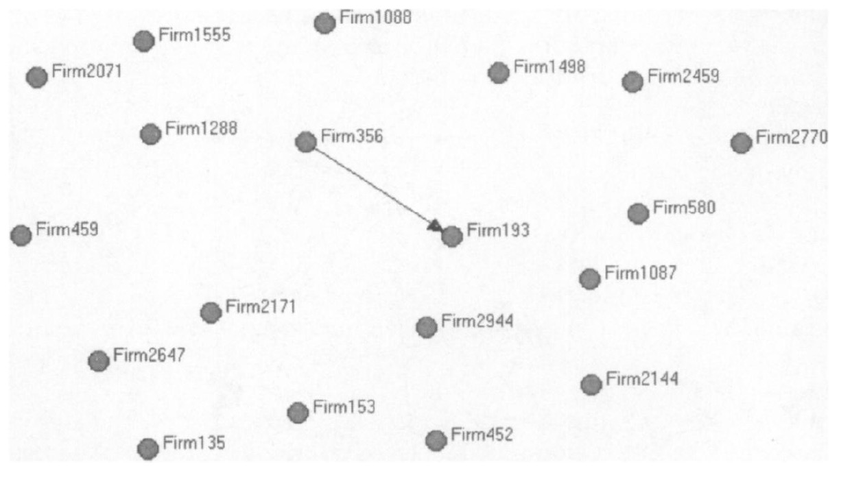
2.1 Market level analysis
Sparse syndication network
Non-high-tech ventures in Pennsylvania over the 5-year-window 1990 to 1994.

Slide 16
2.1 Market level analysis
Density measurement
Directed matrix (asymmetric)
A tie between i and j only if one of them lead-managed a syndicate
Undirected matrix (symmetric)
A tie any participation by both VC firms i and j in a syndicate

Slide 17
2.1 Market level analysis
Density Calculation (With N incumbents)
Max undirected ties: ½*N(N-1), Max directed ties: N*(N-1)
Let p = 1 if VCs i and j have an undirected tie in market m
Let q = 1 If VCs i and j have a directed tie in market m
Symmetric density equals:
Asymmetric density equals:

Slide 18
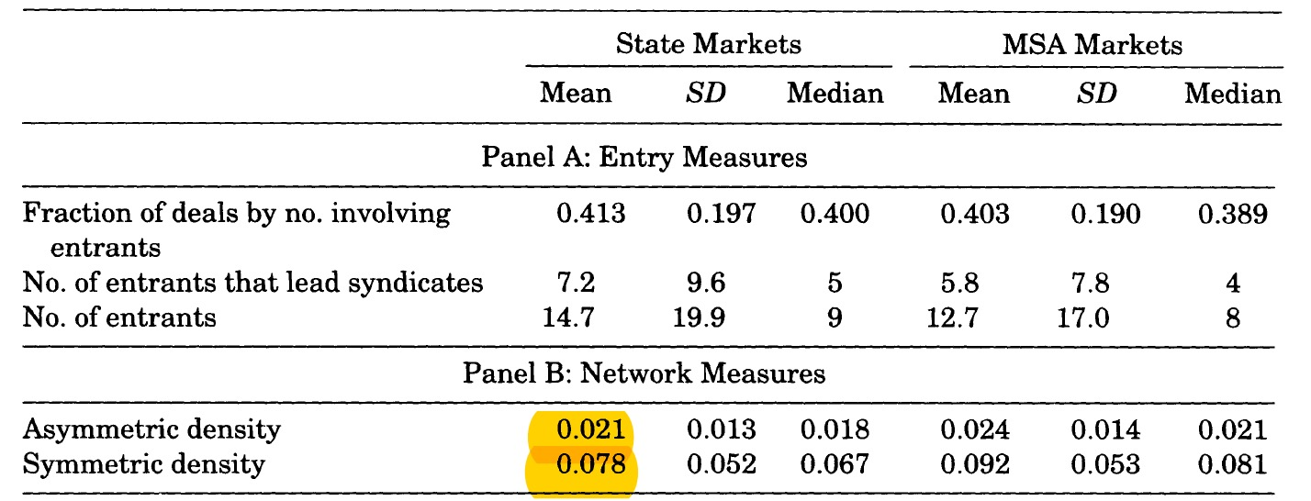
2.1 Market level analysis
Network Measures
The mean of asymmetric density under the State market measurement is 2.1% and the mean of symmetric density is 7.8%
The numbers are slightly different between State Markets and MSA Markets.

Slide 19
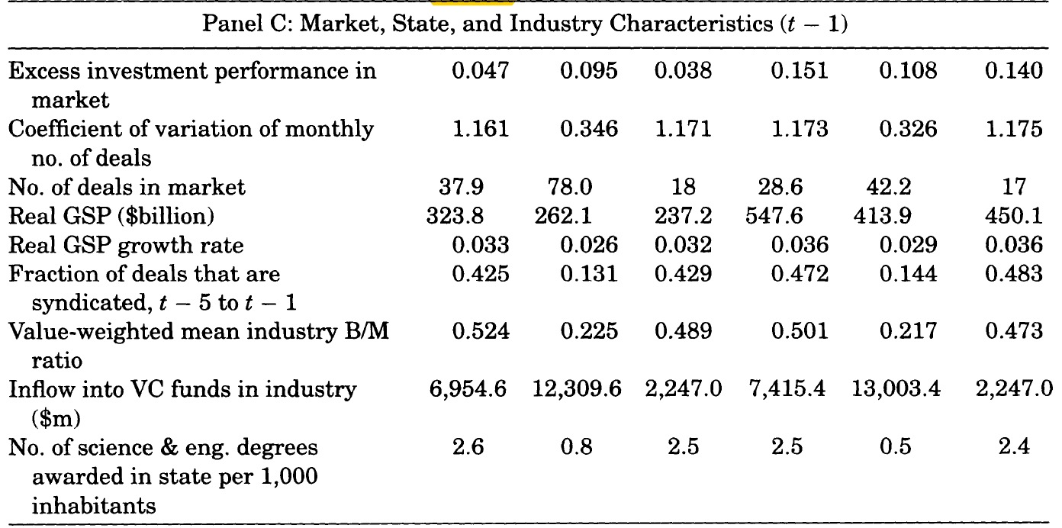
2.1 Market level analysis
Market Characteristics
Investment Performance
Market Demand
Investment Opportunities
Talent Pool

Slide 20
2.1 Market level analysis
Potential Entrants
Founded before year t
Raised fund in the previous 6 years
Never invested in target market before t

Slide 21
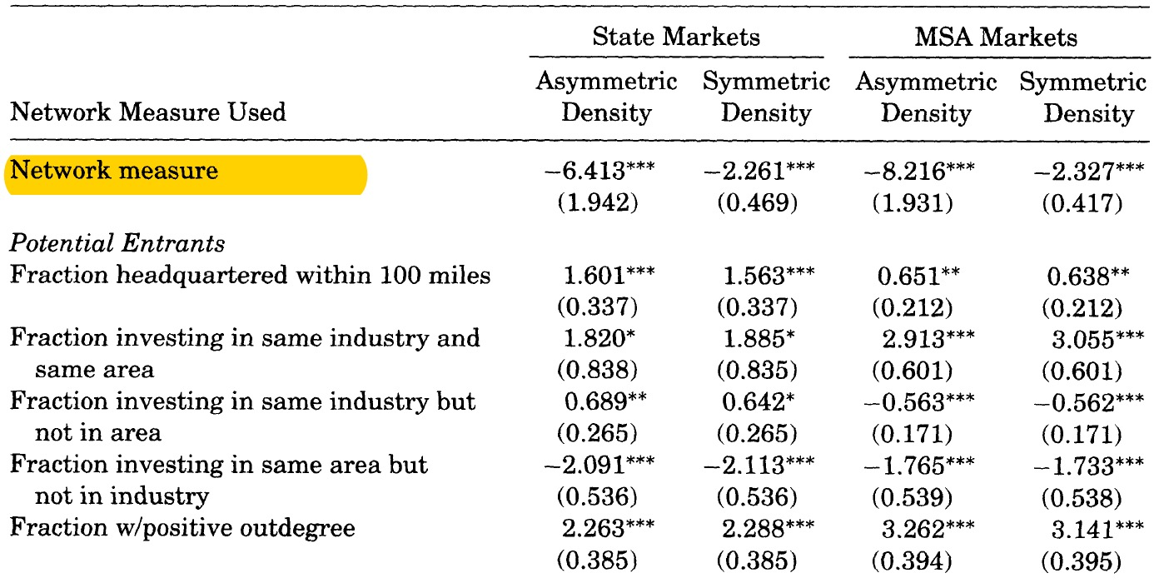
2.1 Market level analysis
Naïve regression model result
The dependent variable is the number of deals won by Entrants.
Strong negative and significant relation between the extent of networking and entry.
Endogenous?

Slide 22
2.1 Market level analysis
Two Approaches
Instrumental Variables to deal directly with the potential endogeneity of networking
Nested panel structure of data to construct proxies for two likely types of omitted variables (correction for omitted variable)

Slide 23
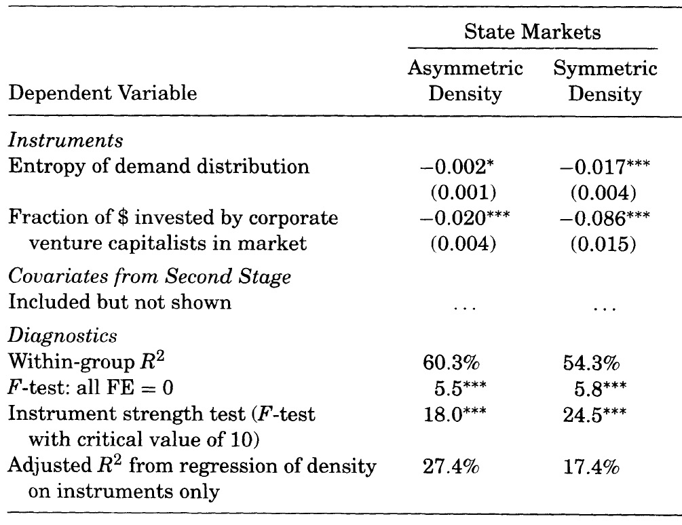
2.1 Market level analysis
Instrument Variables Reasoning
Corporate VCs are more likely to syndicate for opportunistic reasons rather than to deter entry
More frequent interaction helps VCs form ties, leading to denser network

Slide 24
2.1 Market level analysis
Entry Models using two -stage estimators
Failure to account for endogeneity causes us to underestimate the effect of networking density.
Naïve entry model

Slide 25
2.1 Market level analysis
Correction for omitted variables
Nested structure of panel allows to investigate the effects of omitted variables without relying on instruments.

Slide 26
2.1 Market level analysis
Entry models with correction for omitted variables
Both models support the interpretation that more densely networked markets are associated with less entry, even after accounting for possible omitted variables that make networking endogenous to entry.
Entry models using two-stage estimators

Slide 27
2.2 Firm level analysis
How to overcome networking-related entry barriers
They use the Maximum Likelihood Estimation of Logit and Probit models
The single most significant determinant of the entry decision is location
Previous related investment experience is helpful

Slide 28
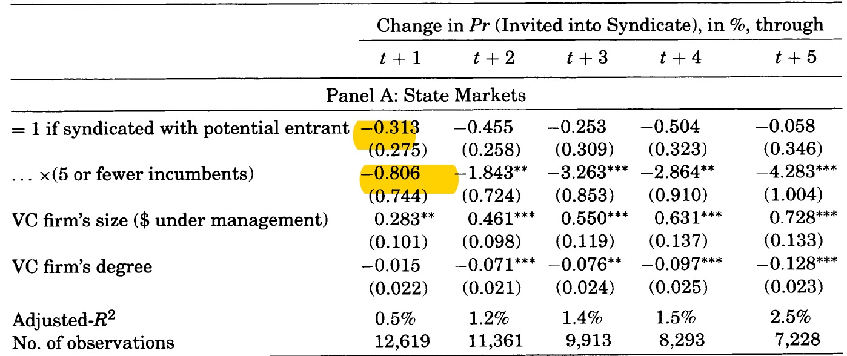
2.3 Punishment
In markets with few incumbents, doing business with a potential entrant reduces the probability of inclusion in home-market syndicates the next five year

Slide 29
2.4 Valuation effects
Effect
A standard deviation increase in density is associated with a more than 10% decrease in valuation from the unconditional mean of $25.6 million
The more market share entrants have gained, the higher valuations VCs provided
Shortcoming
Only 1/5 of funding rounds in the VE database disclosed valuation
Absence of company-level data on value drivers

Slide 30
2.5 Alternative explanations
Alternative explanations due to the limitations of the data on hand
Entrants are likely to be at a competitive disadvantage in sourcing deal flow
We don’t know the covenants that entrants provide to start-ups

Slide 31
3.1 Insights
The result is useful for entrepreneur to evaluate VC’s offers
More likely to raise fund in the next round if backed by a densely networked VC
The criteria and data applied to measure firm level analysis are out of date
Firm level analysis result shows that location is significant
Useful for PE secondary market
Investors can evaluate projects from different perspective

Slide 32
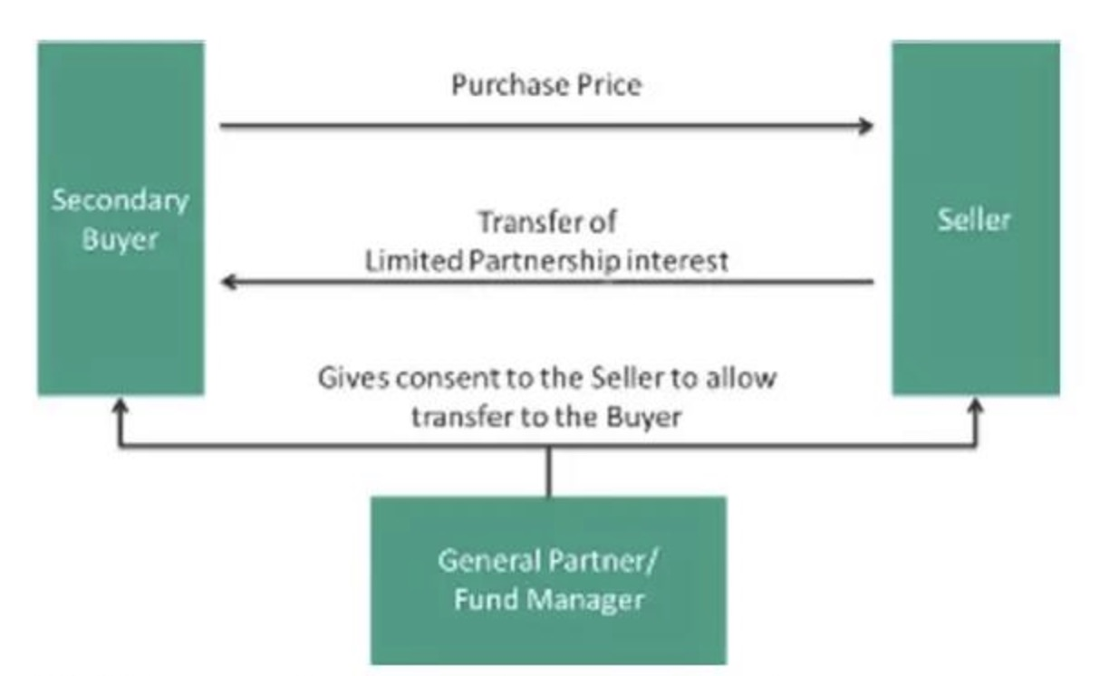
3.2 PE Secondaries
PE Predicament
5-7 years investment period
2-3 years Queueing time
Limited exit channels
Secondary market
Initiative
Alternative Strategy
Liquidity

Slide 33
3.2 PE Secondaries
The market cap boomed from $8.5bns to $37.8bns in the last decade
It is the most profitable investment strategy in private equity market
Provide more confidence to LPs and GPs

