Slide 1
Why Have Economic Reforms in Mexico Not Generated Growth? Timothy J Kehoe and Kim J Ruhl
FIN 500R Topics on Quantitative Finance
Stefan Yu
September 2018

Slide 2
About the Publication
Journal of Economic Literature, December 2010
“JEL issues contain commissioned, peer-reviewed survey and review articles, book reviews, an annotated bibliography of new books classified by subject matter, and an annual index of dissertations in North American universities.”
Notes:
Source: https://www.aeaweb.org/journals/jel/about-jel

Slide 3
About the Authors
Timothy J Kehoe
PhD in Economics, Yale 1979
Adviser, Federal Reserve Bank of Minneapolis, 2000–present
President, Society for Economic Dynamics, 2015–present.
Research Associate, National Bureau of Economic Research, Economic Fluctuations and Growth Program, 2006–present.
Supported reforms to open Mexico’s market in 1992, 1994, 1995
Kim J Ruhl
PhD in Economics, University of Minnesota 2004
Research Associate, Center for International Price Research
Research Associate, Globalization and Monetary Policy Institute, Federal Reserve Bank of Dallas
Associate Editor, Economic Letters, 2012–present
Associate Editor, International Economic Review, 2017–present

Slide 4
Why is this paper interesting (or applicability)

Slide 5
Notes:
Most notably, big emerging markets are slowing down

Slide 6
Notes:
While changes to NAFTA are impacting Mexico and new Emerging markets are outperforming. The study sheds light on drivers for economic growth and can help us understand macroeconomic trends

Slide 7
Summary

Slide 8
Core thesis:
Under a balanced growth model, the industrial leader will grow at a constant rate.
Developing countries can grow faster than the leader with improved institutions and policy reform.
Growth potential depends on the distance from the industry leader¹
China has experienced more growth because its starting point as measured by real GDP per working-age person (rGDP-wap) is lower than Mexico’s (20K vs 5K)

Slide 9
Mexico has stagnated while China has boomed
Factor driving China growth:
Productivity improvement measured by TFP
Factors impeding growth in Mexico
Inefficient financial institutions
Insufficient rule of law
Rigid labor markets
Same factors do not affect China because China has not reached the same level of economic development (rGDP-wap) as Mexico
These factors might affect China in the future

Slide 10
Scope of Research

Slide 11
Focus
Identify factor(s) impeding growth in Mexico but not in China, or factor(s) aiding growth in China but not in Mexico
Focus on impacts of reforms that opened the market to Foreign Investment and trade
Measuring changes in real GDP, productivity, welfare due to trade
Focus is mainly on growth of real GDP per working-age person, which is assumed to be the best approximation of economic production
Using a growth model, the factor would need to address Total Factor Productivity (TFP) stagnation in Mexico and growth in China respectively

Slide 12
Methodology

Slide 13
Approach
Comparing Mexico to China, 1985-2008
Review existing literature for conclusions
Suggest own theories and next steps

Slide 14
Analytical Tools
Real GDP per Capita vs Real GDP per working-age person
Measuring economic ability to produce goods & services
Working age : 15-64
Real GDP vs Real GDI
Real GDP per capita used as indicator for economic growth
Real GDI per capita used as indicator for welfare
Total Factor Productivity
The measure of output not explained by labour and capital

Slide 15
Overview

Slide 16
Mexico vs China, 1
Mexico | China
7% (2nd) | 12.7% (1st)
5.4% (3rd) | 22.3% (1st)
8.5% (2nd) | 33.4% (1st)
3.2% (7th) | 14.8% (1st)
EM merchandise trade, % of total
1995
2008
EM FDI, % of total
1995
2008

Slide 17
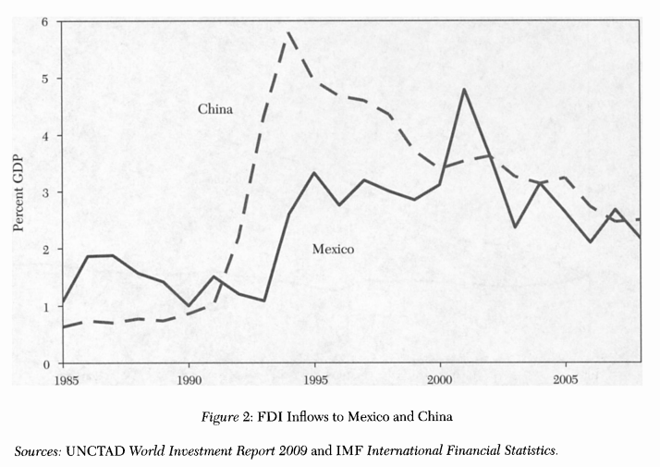
Mexico vs China, 2
1994 – NAFTA established

Slide 18
Mexico vs China, 3
Between 1985 and 2008:
China’s rGDP wap grew 510%
Mexico’s rGDP wap grew 10%

Slide 19
Existing Literature on growth factors

Slide 20
Factor 1: Cross-Country Growth Regression, 1 of 2
Measuring country openness (via trade policy) and correlation with economic growth, a series of papers and rebuttals
A 1995 study³ found open countries experience “on average 2.5% per year higher growth in real GDP per capita”
Mexico classified as open since 1986, China classified as closed
A 2003 follow-up study⁴, focusing on average tariff on imports on capital and intermediate goods, showed tariff’s negative effect on growth controlling for initial GDP per capita
A 2007 paper⁵ comments that “openness seems to have a more positive effect on poorer countries than on middle income countries”
Authors note that these ‘openness’ measures might be flawed and cannot be assumed an accurate reflection of trade policy

Slide 21
Factor 1: Cross-Country Growth Regression, 2 of 2
INCONCLUSIVE
Conclusions
Strong positive correlation: Trade as Share of GDP vs. Growth rate
BUT trade share does not directly measure policy
Openness policy vs growth - relationship empirically not robust
Strong positive, weak positive, none
Openness only good for developed countries⁶, better for developing countries⁴, bad for less developed countries⁷
Lack of comparable theoretical models in research
Some do not use any
Others use endogenous growth models⁸ where all else being equal, larger countries should grow faster
BUT empirical evidence mixed

Slide 22
Factor 2: Stagnant Mexican Economy
One: Inefficient Financial system
Mexico vs Chile comparison⁹ showed misallocations of labor and capital in an efficient system. Inefficient bankruptcy processes prevent new firms from entering the market. Both hurt TFP
Two: Lack of contract enforcement
In several studies¹⁰ of post-1994/95-crisis Mexico show the traded goods sector growing much faster than non-traded goods. Non-traded goods were hampered by financing issues domestically due to lack of contract enforcement e.g. when loans go bust.
China
Has same issues but still grew at an astounding pace
INCONCLUSIVE

Slide 23
Factor 3: China Factors
Strong Central Government hypothesis
Deemed unlikely for two reasons
Mexico became a democracy in mid 1990s, before which a one-party system ruled. Misallocation of resources already identified in one-party period⁹
Banking system was inefficient and government credit allocation was also an issue in China¹⁴
INCONCLUSIVE

Slide 24
Factor 4: Impact of Trade on Welfare Growth
“Standard trade models do not imply that opening to trade increases productivity or real GDP, but that it increases welfare”²
Many models support increase in welfare
Welfare in Mexico increased more than rGDP data indicate
E.g. import penetration measure
Changes as % of real GDP are similar between Mexico 1990-2000 and China 1998-2008, but Mexico has greater absolute gain
Using real GDI as measure, welfare gains from trade is empirically verifiable
Assuming real GDI is an accurate measure of welfare
Assuming correlation between import penetration and welfare is causal

Slide 25
Factor 4: Impact of Trade on Real GDP
Theoretical model predictions¹⁵ of impact of tariff reduction (trade increase) on real GDP are inconclusive
Real GDP and tariff related in 2 ways²
Change in real GDP due to factor prices
Change in real tariff revenue
Net effect yields change in Real GDP
In this paper, measured two gains
Gains from terms of trade (export vs import prices)
Gains from new varieties
Assuming higher GDP growth was not a gain from trade, then Mexico gained more from trade than China

Slide 26
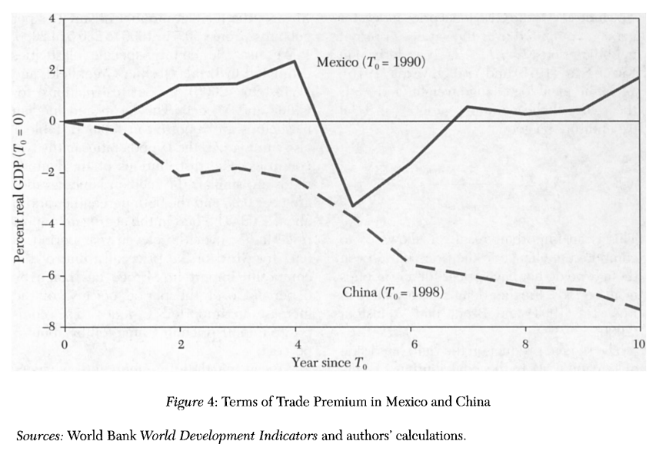
Gains from terms of trade
Measuring with GDI
Components deflated by price indices (like real GDP)
Trade balance deflated differently
Exports valued in terms of how many imports they can purchase
Impact of trade over 10-year period paints different picture (refer to figure 4)

Slide 27
Gains from New Varieties, 1 of 2
When constant elasticity of substitution is present (CES) the impact of new varieties on price can be measured as utility
Even without initial price¹⁶ the gain due to new varieties can be calculated¹⁷
Assuming the set of goods is constant and the set of varieties of each good can change, an “composite import good” and “composite domestic good” can be calculated.
All varieties of good assumed to have same elasticity of substitution
By comparing the aggregates, the “aggregate import bias” can be measured in terms of the value of the goods
Goods were defined by a 3 digit code
Variety was defined by a 6 digit code + country

Slide 28
Gains from New Varieties, 2 of 2
Median varieties per good
In China, 300.5 to 406.0 (1998-2008)
In Mexico, 150.5 to 230.5 (1990-2000)
Country specific elasticities of goods from 2006 study¹⁸ used for calculations of utility
Lamba-ratio shows how changing variety affects expenditure on a set of goods. A ratio of 1 isn’t affected. Ratio is affected by substitutability (-) and weight (+) of traded goods
Calculate finally the income needed to achieve same increase in utility, without increase in variety.
Notes:
= less is more
+ = more is more

Slide 29
INCONCLUSIVE
On average, new varieties lower expenditure
Average price of goods has fallen
But value-add of new varieties less in China
China rGDP at PPP: $2,325 -> 2,177
Mexico rGDP at PPP: $10,121 -> 10,440

Slide 30
Summary of Results
Factor 1: Openness of market
seems to have empirical positive correlation with growth, but not robust relationship
Factor 2: Mexico’s endogenous market limitations
Observed in China as well but do not limit China’s growth
Factor 3: China resource allocation and productivity in manufacturing
Also observed in Mexico during comparable timeframe
Factor 4: Trade impact on GDP growth
Complex relationship, approximated trade via tariffs
Trade improves welfare, and Mexico improved more than China.
Doesn’t explain GDP growth challenge

Slide 31
New Theory

Slide 32
Factor 5: Productivity
Measure growth using a model by Kehoe and Prescott (2002, 2007) featuring function where Y is output, A is TFP, K is capital, and L is labor input
Rewriting the equation as yields a growth in output (rGDP wap), productivity factor, capital factor, and labor factor
All other factors being equal, Y_{t}/N_{t} is approximated by A_{t}^{1/(1-alpha)}

Slide 33
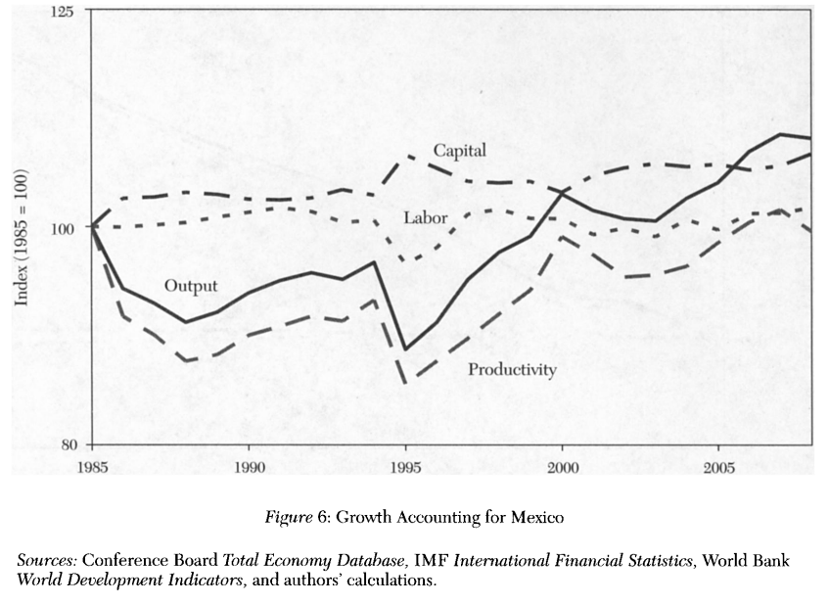
Other models¹⁹ look at increases output per worker as a function of variables including capital per worker and conclude that capital and FTP increases contribute equally to growth.
This model assumes an increase in capital is caused by increase in productivity, to maintain a constant capital-output ratio.
Capital factor increases are only attributed when increases in the capital-output ratio occur.

Slide 34
Factor 5: Productivity
TFP growth driving economic growth
Productivity differences in firms¹¹ accounted for a lot of the TFP growth
Reallocation of resources from inefficient firms to efficient firms¹² especially in manufacturing sector
However, productivity was increasing in Mexico too, especially in manufacturing¹³
issue seems to be in other sectors of economy (e.g. services, technology)

Slide 35
Other Considerations
Other growth drivers (i.e. not openness of market)
FDI transfer of technology¹⁹
Role of international trade in incentivizing new technology adoption²⁰
Is openness to trade and FDI necessary for rapid growth?
Looking at India growth
How to re-activate catch-up growth in Mexico / stagnated nations?
Hypothesis: Promote competition in oil extraction, electricity, telecom, transportation

Slide 36
Productivity and GDP
If productivity is low, growth of income per capita is low
Parente and Prescott (2002) model suggests government policies and institutions like monopolies impede new technology and therefore productivity
William W Lewis (2004) case studies shows productivity across many sectors is necessary for growth in income, and government policies preventing best available global technologies from entering keep countries relatively poor

Slide 37
Mexico vs China – why the difference
Mexico trade and FDI largely with USA
Reduce competition and innovation
Complementary manufacturing
China provides substitute manufacturing products with USA and Mexico
Reduce incentives for innovation
Relativity of GDP per capita strength

Slide 38
Growth Trends

Slide 39
USA

Slide 40
Mexico

Slide 41
China (estimate)
In 2008:
China GDP wap 7,896
China GDP pc 5,712
Mexico GDP wap 20,755
Mexico GDP pc 14,434
Explosive growth since 1985

Slide 42
Final Thoughts
The paper conducted a broad and critical analysis of existing literature from multiple angles
Certain comparisons amongst different time periods might not be apt due to the global economic climate e.g. 1990-2000 Mexico vs 1998-2008 China
Proposed factor responsible for the difference in growth makes intuitive sense and is supported by the numerical analysis
Conclusions applicable to new emerging markets such as India, South Africa, and Brazil. Its stance in support of open trade is an especially interesting topic in the current macro environment of trade wars and protectionism, with China slowing down although it is still far from reaching U.S. per capita wealth.
VALID

Slide 43
References
Stephen L Parente and Edward C Prescott (1994, 2002) and Timothy J Kehoe and Edward C Prescott (2002, 2007)
Claustre Bajone et al. (2010)
Jeffrey D Sachs and Andrew M Warner (1995)
Andrew M Warner (2003)
Francisco Rodriguez (2007)
Steve Dowrick and Jane Golley (2004) and David N DeJong and Marla Ripoll (2006)
Halit Yanikkaya (2003)
Luis Rivera-Batiz and Paul M Romer (1991) amongst others
Raphael Bergoeing et al (2002, 2007)
Anne Krueger and Aaron Tornell (1999) and Aaron Tornell, Frank Westerman, and Lorenza Martinez (2003)
Loren Brandt and Xiaodong Zhu (2010)
Chang-Tai Hsieh and Peter J Klenow (2009)
Ernesto Lopez-Cordova (2003)
Bajona and Tianshu Chu (2010)
Ricardian models by Rudiger Dornbusch, Stanley Fischer, and Paul A Samuelson (1977) and Jonathan Eaton and Samuel S Kortum (2002) Imperfect Competition models by Paul Krugman (1980) and Marc J Melitz (2003)
Feenstra (1994)
Christian Broda and David E Weinstein (2006)
Broda, Joshua Greenfield, and Weisntein (2006)
Natalia Ramondo and Rodriguez-Clare (2009) and Ellen R McGrattan and Prescott (2009)
Thomas J Holmes and James A Schmitz (2001), Schmitz (2005), Mark J Gibson (2007)

Slide 44
Presentation Goal
The presentations should reflect a sophisticated understanding of the papers' assumptions and conclusions, and the presentation should include a critical analysis of the paper's validity and applicability.

