Slide 1
Mutual fund performance evaluation with active peer benchmarks
David Hunter, Eugene Kandel, Shmuel Kandel, Russ Wermers
Present by Jianyi (Alex) Xu

Slide 2
Objective
Does active management produce persistent superior investment performance?
How to fairly evaluate the performance of active management?

Slide 3
Objective
The intuition behind the choice of the group return as an explanatory variable
The data and the empirical methodology
Results
Conclusion

Slide 4
Intuition

Slide 5
Evaluating Active Managers
Jensen’s (1968)alpha:
Fama and French(1993) three-factor model:
Carhart’s (1997) four-factor model:
EXMKT : CRSP value-weighted index less the risk free rate
HML : monthly premium of the book-to-market factor
SMB : the monthly premium of the size factor
UMD :the monthly premium on winners minus losers

Slide 6
Evaluating Active Managers
A problem with performance evaluation is the presence of similar strategies among funds, which produces correlated residuals from commonly used models.
For example, the majority of mutual fund managers use momentum as part of their stock-picking strategies, and commonly prefer stocks with higher levels of liquidity.

Slide 7
Time Series Residuals
A good forecasting method will yield residuals with the following properties:
The residuals are uncorrelated. If there are correlations between residuals, then there is information left in the residuals which should be used in computing forecasts.
The residuals have zero mean. If the residuals have a mean other than zero, then the forecasts are biased.
The residuals have constant variance.
The residuals are normally distributed.

Slide 8
Methodology in the Paper
The approach in the paper is to form an additional benchmark from the group of funds to which a given fund belongs, as each fund manager chooses the peer group with which it intends to compete.
Using this reference group return is much simpler than trying to identify the potentially exogenous factors that represent the many complex strategies that could be used by funds within a group.

Slide 9
Methodology in the Paper
We use data on US mutual funds specializing in equities. We measure performance using the standard four-factor model, then compare this with measurements using the four-factor model augmented by the APB factor.

Slide 10
The Econometric Model
In this subsection, we outline the econometric advantages of using the peer group return, in addition to the traditional risk factors.
the gross excess return of fund i at time t:
$R_{i,t}$: the actual reported return of fund i during month t, which is net of the management fee and trading costs.
$m_{i,t}:$the periodic management fee that fund i charges at period t.
$r_{f,t}$ : the risk-free rate for the same period.

Slide 11
The Econometric Model
We define, by $r_{APB,t}$, the average gross excess return of the active peer group of funds to which fund i belongs:
$N_{APB}$: the number of funds in the APB to which fund I belongs.
Next, we discuss a simple model to illustrate the potential advantages of adding the APB to the traditional estimation of a model.

Slide 12
The Baseline Model
The noise component of the APB and the individual fund return is likely to be positively correlated due to commonalities in risk-taking, and the APB can be treated as a zero skill asset.
Consequently, the estimation of individual fund alphas could be improved by adding the APB to the standard set of benchmarks.

Slide 13
The Baseline Model
Formally, let us assume that the fund i errors have the following structure (here, we assume just one priced risk factor for simplicity):
$L_{t}:$ a zero-mean random variable (an unpriced risk factor)
$ω_{i,t}:$an independent and identically distributed (across funds) error term
We can obtain unbiased estimates of $α$directly with Eq3. Thus, APB-augmented model is undertaken only to increase the precision of the estimator of $α$ .

Slide 14
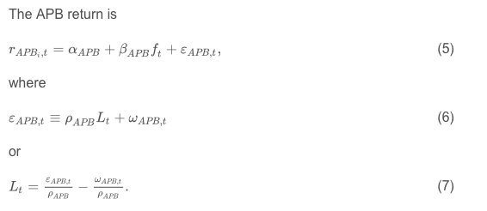
The Baseline Model
Similarly, we have:

Slide 15
The Baseline Model
Substituting this expression for $L_{t}$ into Eq.3, the model for a single fund is:
Eq.8 suggests that adding the model residual for the APB, $ε_{APB,t}$, to the standard asset pricing model [Eq.3] will result in a lower-variance residual.
Whether this translates into more precise parameter estimates, depends on whether a particular fund's residual, $ε_{i,t}$, is sufficiently correlated with the APB residual, $ε_{APB,t}$.
A sufficiently (positive) correlation is necessary so that $ε_{APB,t}$does not act as a nuisance parameter.

Slide 16
The APB-Adjusted Alpha Model
Suppose that all funds in a peer group generate alphas through the same strategy, except some fund managers leverage this strategy more than others.
Such differences in aggressiveness of investment strategy can be motivated by differential risk-aversion among fund managers.
In such a case, we would observe alphas that are merely a leveraging of the common peer group alpha and not due to individual fund manager skills.

Slide 17
The APB-Adjusted Alpha Model
We introduce a variant of Eq.8 that helps us to determine whether unique fund manager skills exist. We call this version the “APB-adjusted alpha model”:
We add the APB alpha to its residual as the additional factor in Eq9. The APB-adjusted alpha, $α_{i}$, equals the unadjusted alpha of Eq8, $α_{i}$, minus $\frac{ρ_{i}}{ρ_{APB}}α_{APB}$.
If, for example, fund i merely generates a return that is a k-leveraged APB return plus (uncorrelated) noise, $r_{i}=kr_{APB}+ε_{i}$, then Eq9 assigns the manager a zero alpha.

Slide 18
Data and Methodology

Slide 19
Fund Categorization
Mutual fund advisers choose a passive benchmark against which to compare each fund's performance.
Because there is no large penalty for choosing an inappropriate benchmark, mutual fund managers are incentivized to choose easy-to-beat benchmarks.
For example, among funds self-identifying with a particular Russell passive benchmark, 31.2% have a better match with a different Russell benchmark.

Slide 20
Fund Categorization
We obtain the best fit benchmarks for most equity mutual funds during the January 1980 to December 2010 period from Martijn Cremers and Antti Petajisto, and then map these benchmarks to a smaller set of major benchmarks.

Slide 21
Fund Categorization
The majority of US equity mutual funds define their benchmarks on size as well as value and growth dimensions.
Thus, our final set of nine best fit benchmarks are large-capitalization (value: Russell 1000 Value, core: Russell 1000, growth: Russell 1000 Growth), mid-capitalization (value: Russell Midcap Value, core: Russell Midcap, growth: Russell Midcap Growth), and small-capitalization (value: Russell 2000 Value, core: Russell 2000, growth: Russell 2000 Growth).

Slide 22
Baseline Model
We use the four-factor model as our baseline performance evaluation model, against which we test alternative specification that augments the model with active peer group benchmark (APB).
The four-factor model applied to fund i is:
We run this regression over three-year periods, on funds having at least 30 months of NAV returns available during that three-year period.

Slide 23
Augmented Model
Our alternative specification adds the regression residuals for the APB, $ε_{APB,t}$, to the four-factor model for fund i. We apply the following model to each individual mutual fund, i:
The regression of Eq11 helps to control for commonalities in idiosyncratic risk-taking by funds within the same APB group.
We also apply an APB-adjusted alpha version of this augmented model:

Slide 24
Augmented Model
The source of a fund's performance comes from unique manager skills that are uncorrelated with the active peer group's average skills, then alpha is identical under both of the above models.
If the source of a fund's performance comes entirely from co-movement related effects (represented by $λ_{i}α_{APB}$), then $α_{i}=0$.

Slide 25
Result

Slide 26
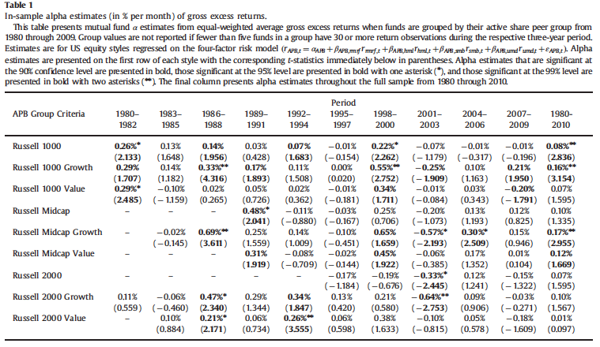
Performance of Active Peer Group Benchmarks
We run four-factor regressions of the APB, for each group of funds, over three-year periods from 1980 to 2009.

Slide 27
Performance of Active Peer Group Benchmarks
Table 1 shows that all equity APBs exhibit significant $α$'s during at least some three-year periods, and some exhibit them during more than half of the sub-period.
However, time-varying estimated APB alphas could also be due to common estimation error in three-year alphas.
The large number of significant three-year alphas indicates a significant amount of commonality in residuals among funds.

Slide 28
Correlation Between APB Residuals
The APB alphas tend to be of the same sign during a particular three-year period. This indicates that commonality in idiosyncratic risk-taking could exist among funds belonging to different APB groups.
Accordingly, we compute across-group correlations between equal-weighted APB residuals from the four-factor regression.
Under the null of uncorrelated fund strategies across different groups, we expect to find correlations that are not significantly different from zero.
To test this, we compute correlations between APB groups over the 30-year period from 1980 to 2009.

Slide 29
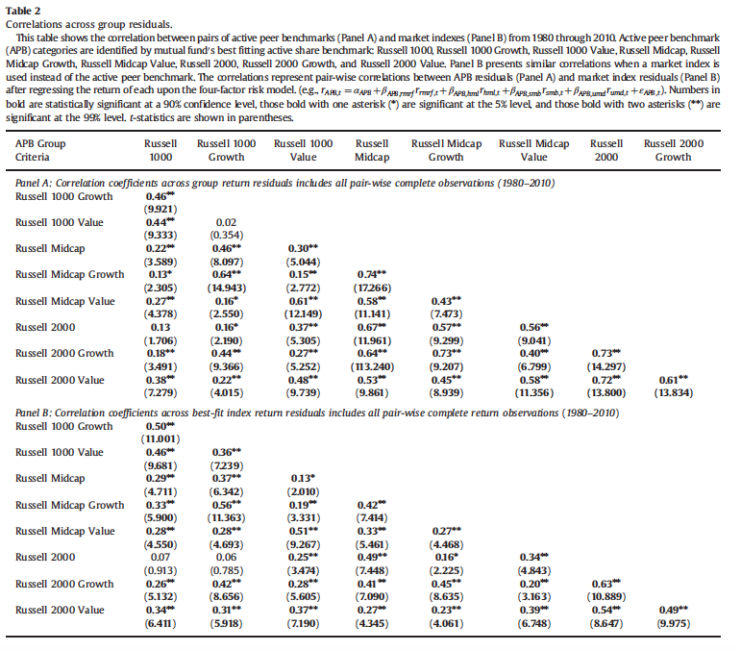
Correlation Between APB Residuals

Slide 30
Correlation Between APB Residuals
Panel A shows evidence of across-group commonality in idiosyncratic risk-taking, as we can reject the null of no correlation between APB residuals frequently.
Especially dramatic are the residual correlations involving mid-cap or small-cap fund groups. Some of this comes from the overlap in the indexes, but some also could result from funds that do not fit within one APB group.

Slide 31
Correlation Between APB Residuals
In Panel B, we test whether these high correlations are due to the overlap in indexes or to the potential inability of the four-factor model to price index returns precisely, or both.

Slide 32
Correlation between Individual Equity Fund Residuals
Next, we evaluate the performance of the four-factor model at the individual fund level. If the four-factor model captures systematic variation in returns properly, then the residuals exhibit commonalities with each other only due to their loading on similar idiosyncratic factors.

Slide 33
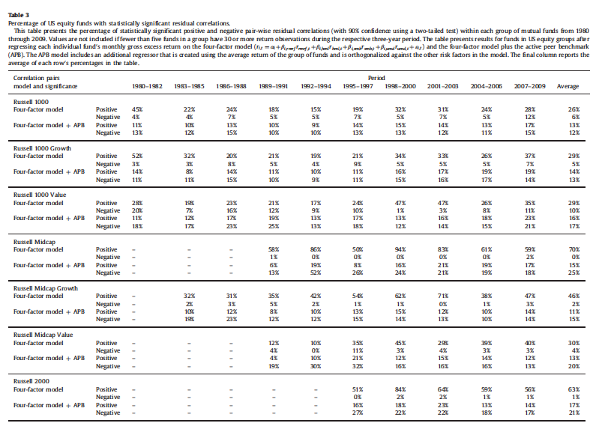
Correlation between Individual Equity Fund Residuals
Table 3 presents the percentage of significantly positive and the percentage of significantly negative.

Slide 34
Correlation between Individual Equity Fund Residuals
The percentage of significant positive correlations, using the four-factor model, is always higher than the percentage of significant negative correlations—and usually it is much higher.
Further, the negative and significant percentage is reasonably constant across time periods and fund groups, and it rarely exceeds 10%.

Slide 35
Correlation between Individual Equity Fund Residuals
To summarize, the results present evidence supporting that standard factors leave a significant unexplained covariation among funds within a group.
And the significant part of this covariation can be controlled by adding the APB to the four-factor model.

Slide 36
Alpha Estimation Diagnostics
In this subsection, we demonstrate the influence of APB on alpha estimation. We compare the traditional four-factor model with the APB-augmented models.
The t-statistic of the alpha could increase with the APB-augmented model, if the APB factor adequately captures commonality in idiosyncratic risk-taking.
Our goal is to determine whether the addition of the APB results in a sharper separation of funds into those with positive and negative alphas.

Slide 37
Alpha Estimation Diagnostics
Columns 4–7 of Table 4 show the percentage of funds having significant factors exposures, respectively. Column 8 shows similar statistics for the APB factor coefficient from the model of either Eq.11 or Eq.12.

Slide 38
Alpha Estimation Diagnostics
To summarize the results of this subsection, a good deal of these funds lose their significant alphas when we control for the alphas earned by the common strategy. Among most peer groups, the fraction of positive and significant alphas decrease, indicating that common strategy alphas are generally positive.
This result brings the possibility that we could capture superior alphas through a passive strategy of investing in an entire group of funds, instead of attempting to choose the best of the peer group.

Slide 39
Out-of-sample Performance
Does our APB model improve the identification of skilled fund managers? And, if so, do these skilled managers use common, or do they use strategies that are distinct from each other? Our out-of-sample tests are designed to determine the answers to these questions.
At the end of each month, starting on December 31, 1982 and ending on December 31, 2009, we rank all US equity mutual funds by the t-statistic of alpha, measured over the prior 36 months. Then, quartile portfolios of funds are formed, and equal-weighted portfolio returns are computed over the following (out-of-sample) year. Next, we compute the alpha over this year. Next, we move forward one month and repeat this process. Finally, we compute time series average alphas and t-statistics of these alphas over all (overlapping) out-of-sample years.

Slide 40
Out-of-sample Performance
Panel A of Table 5 presents results from this exercise. The table shows that, in general, alphas are monotonically decreasing from Quartile 1 (top-ranked funds from the prior three years) to Quartile 4 (bottom ranked funds).

Slide 41
Out-of-sample Performance
In Panel B, we conduct the same ranking and portfolio formation procedures, but we measure the following-year performance with the redefined alpha from the alpha-adjustment model of Eq.12.

Slide 42
Conclusion
This paper proposed a conceptually simple and easily implementable way to control for common, unpriced idiosyncratic risks taken by mutual funds.
The APB decreases the between-fund residual correlations within a group, when the APB is added to standard factor models. This result indicates that the APB successfully captures common idiosyncratic risk-taking.
Finally, we demonstrate that the added APB benchmark significantly improves the identification of skilled (and unskilled) fund managers within several of the equity fund peer groups.

Slide 43
What I Think
The paper improve the four-factor model by introducing a new factor. We could say APB is a good candidate factor. But from the analysis, we still can’t tell if the APB-augmented model is accurate enough.
With the APB term being introduced, the estimation of alpha becomes more accurate. However, there still could be some information left in the residual, which could be extracted by introducing more factors and make the estimation of alpha more accurate.
For example, we could introduce 30 factors in the regression. Then to prevent overfitting, we could reduced the explained variance of the factors to 85% by dimension reduction. But those are beyond the scope of this paper.

Slide 44
What I Think
Plus, there might be other factors that are more effective than the APB factor. However, at the end of the paper, the author tried to introduce several other factors, such as liquidity factor, passive index factor and value-weighted active peer benchmark factor to test the robustness of the model. Thus, I think what discussed in the paper is comprehensive enough.

Slide 45
Thank you!

