Slide 1
Anti-Corruption Reforms and Shareholder Valuations: Event Study Evidence from China
Authors: Chen Lin, Randall Morck, Bernard Yeung, Xiaofeng Zhao 2015
Presented by:
Pengyi Pan

Slide 2
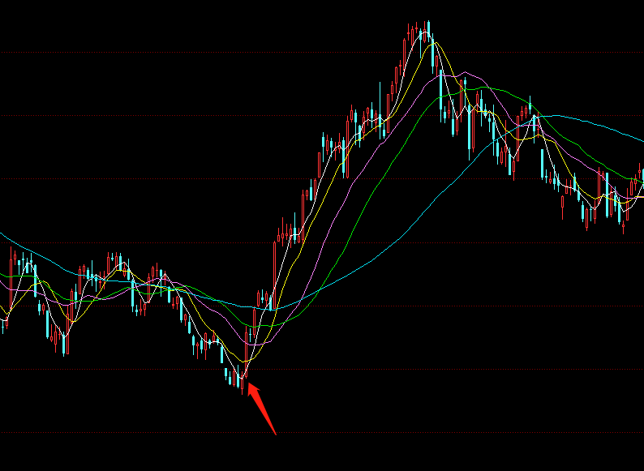
[0/7] Overview
Chinese stock markets rose sharply around Dec. 4th 2012, after the Politburo’s announcement of its Eight-point Regulation (八项规定)

Slide 3
[1/7] Background
Official corruption is a big problem in China (Chen 2003; Jones 2003)

Slide 4
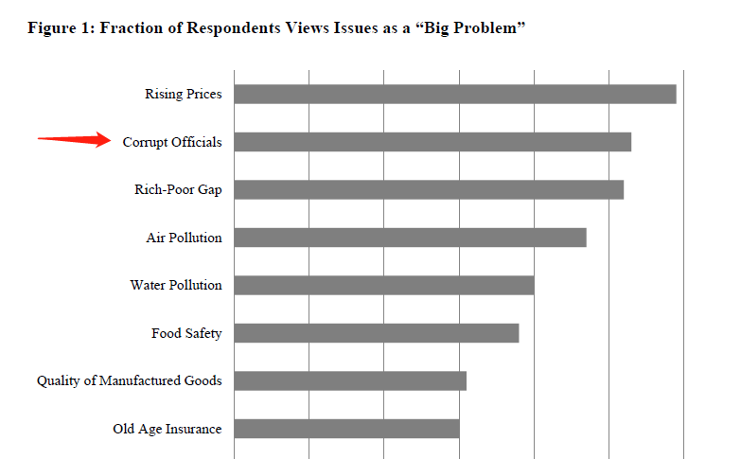
[1/7] Background

Slide 5
[1/7] Background
Official corruption is a big problem in China (Chen 2003; Jones 2003)
Guanxi (关系) with officials becomes a very high return investment for any non-SOEs (McGregor 2010)

Slide 6
[1/7] Background
Official corruption is a big problem in China (Chen 2003; Jones 2003)
Guanxi (关系) with officials becomes a very high return investment for any non-SOEs (McGregor 2010)
Entertainment and travel cost (ETC) as a proxy for investment in “connections”

Slide 7
[1/7] Background
Official corruption is a big problem in China (Chen 2003; Jones 2003)
Guanxi (关系) with officials becomes a very high return investment for any non-SOEs (McGregor 2010)
Entertainment and travel cost (ETC) as a proxy for investment in “connections”
New administration, new changes

Slide 8
[2/7] Eight-point Regulation
Leaders must keep in close contact with the grassroots, but without inspection tours or formality
Meetings and major events are to be strictly regulated and efficiently arranged; empty grand gestures are to be avoided
The issuance of official documents must be reduced
Overseas official visits and related formalities are to be restricted
Leaders traveling by car must avoid disrupting traffic
Media stories about official events are to be limited to events with real news value
Government leaders should not publish self-authored works or congratulatory letters
Leaders must practice thrift and strictly obey regulations regarding accommodation and cars

Slide 9
[2/7] Eight-point Regulation
Start of the anti-corruption campaign

Slide 10
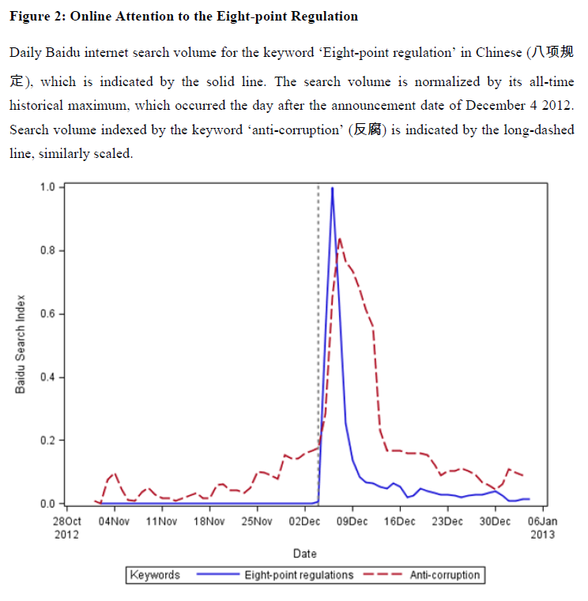
[2/7] Eight-point Regulation
Start of the anti-corruption campaign

Slide 11
[3/7] Methods
Nontraditional event studies -> Market portfolio raw return

Slide 12
[3/7] Methods
Nontraditional event studies -> Market portfolio raw return
Expect some different reactions -> Compare firms with different characteristics

Slide 13
[3/7] Methods
Nontraditional event studies -> Market portfolio raw return
Expect some different reactions -> Compare firms with different characteristics
Further test -> Firm-level regression explaining abnormal returns

Slide 14
[4/7] Data
3 & 5-day market returns around Dec.4th 2012 -> exclude companies with major events

Slide 15
[4/7] Data
3 & 5-day market returns around Dec.4th 2012 -> exclude companies with major events
Entertainment and travel cost (ETC) -> WIND database

Slide 16
[4/7] Data
3 & 5-day market returns around Dec.4th 2012 -> exclude companies with major events
Entertainment and travel cost (ETC) -> WIND database
Province-level marketization index -> National Economic Research Institute (NERI)

Slide 17
[4/7] Data
3 & 5-day market returns around Dec.4th 2012 -> exclude companies with major events
Entertainment and travel cost (ETC) -> WIND database
Province-level marketization index -> National Economic Research Institute (NERI)
SOE/Non-SOE -> China Listed Firm’s shareholder research database -> 30% threshold

Slide 18
[5/7] Results Overview
5 main results found
Theme: Market surged as a whole
SOE rose more than Non-SOE
Non-SOE in developed provinces rose more
Non-SOE with low ETC rose more

Slide 19
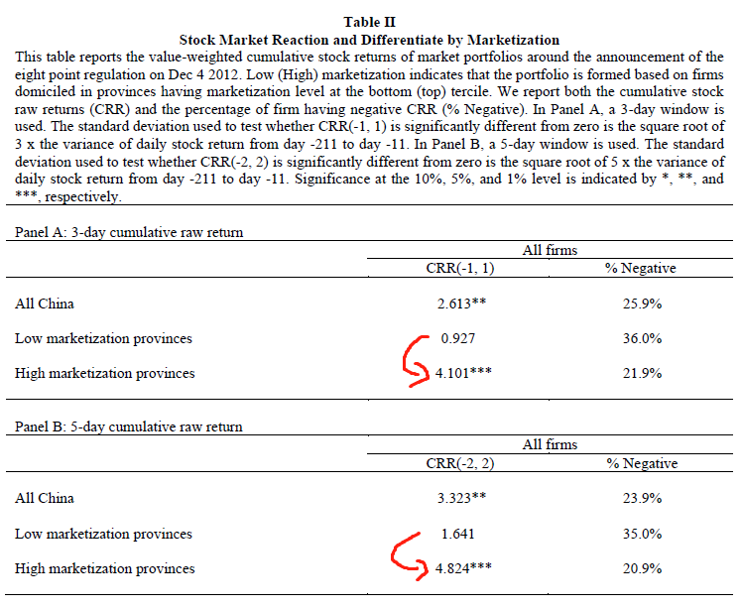
[5/7] Results ⅕
Whole market surged significantly
Companies in more developed provinces rose more

Slide 20
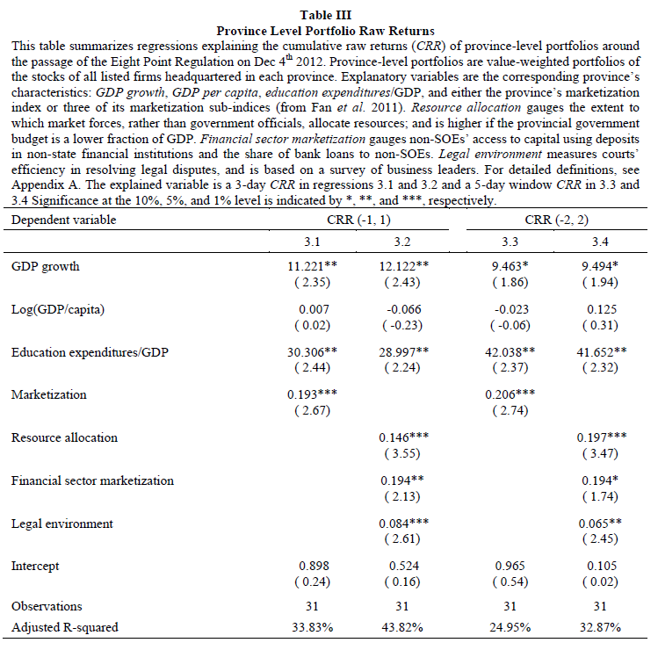
[5/7] Results ⅖
CRR is positively related to province’s business environment and past economic performance

Slide 21
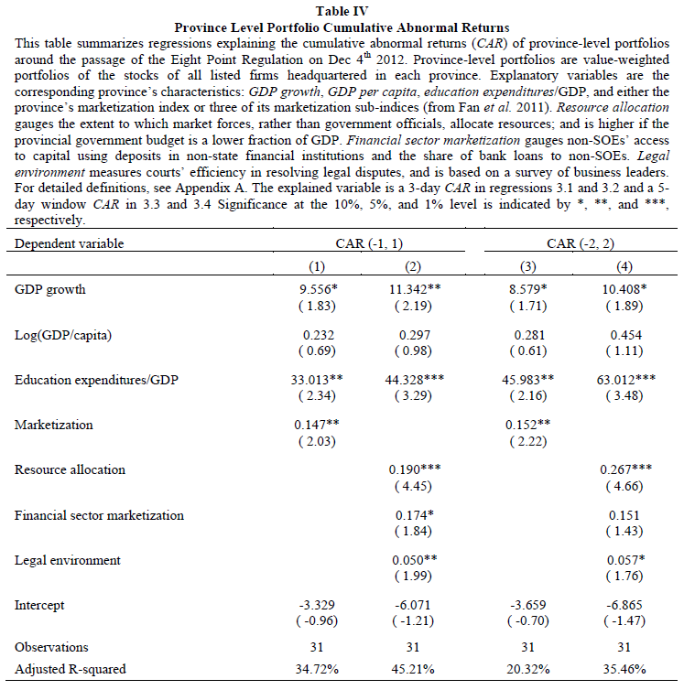
[5/7] Results ⅖
Similar results for CAR

Slide 22
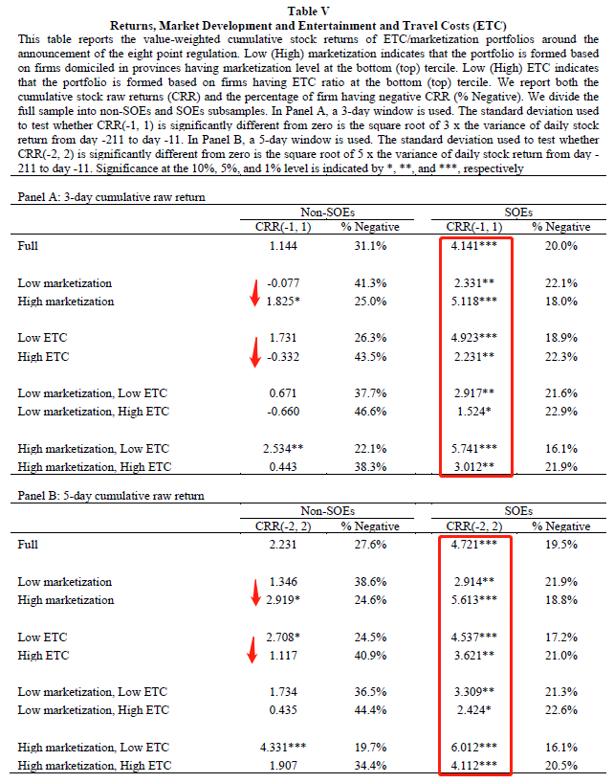
[5/7] Results ⅗
SOEs rose more than Non-SOEs
Companies in high marketization provinces rose more
Companies historically with low ETC rose more

Slide 23
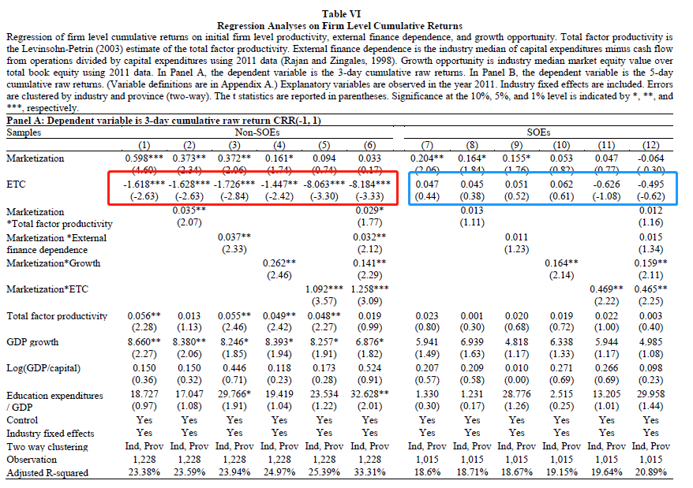
[5/7] Results ⅘
Significant negative correlation between ETC and CRR for Non-SOEs
Not significant for SOEs

Slide 24
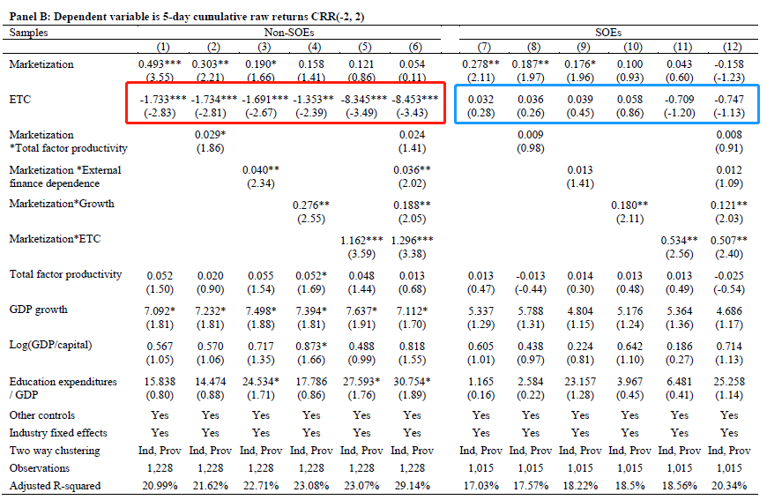
[5/7] Results ⅘
Similar results
Notice the importance of marketization variable

Slide 25
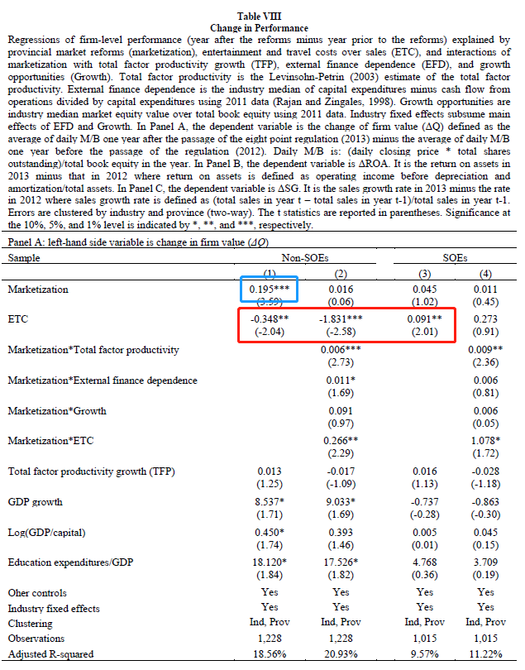
[5/7] Results 5/5
Change in firm value is negatively correlated with historial ETC for Non-SOEs
More reasonable to regress on change in ETC

Slide 26
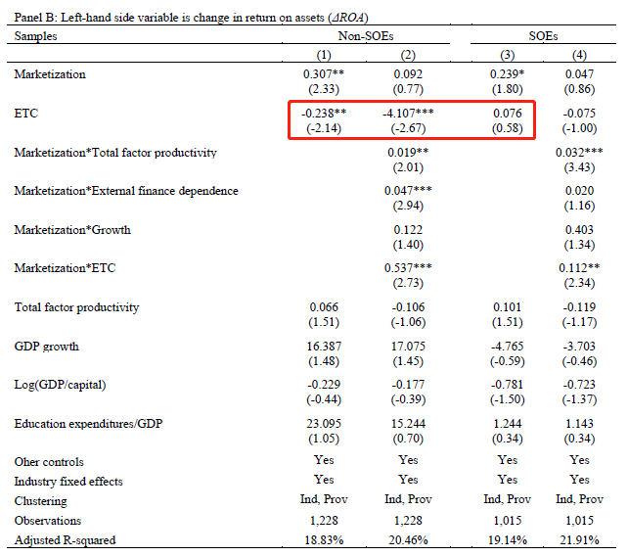
[5/7] Results 5/5
Similar story for change in return on assets (ROA)

Slide 27
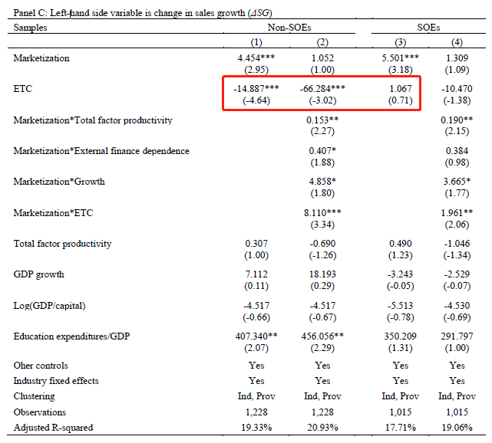
[5/7] Results 5/5
Similar story for change in sales growth

Slide 28
[6/7] Summary
Chinese stock market rose significantly and broadly after the announcement of Eight-point regulation on Dec. 4th 2012
Companies in more developed provinces rose more than those in other provinces
SOEs universally rose while only Non-SOEs in developed provinces and with historically low ETC rose significantly

Slide 29
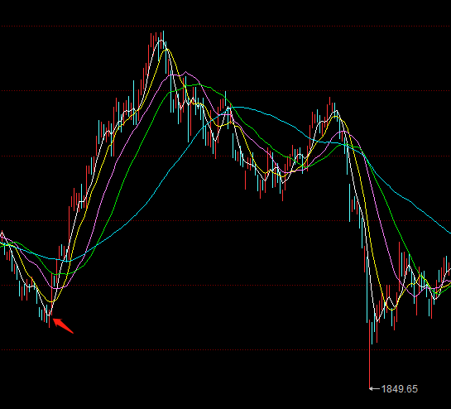
[7/7] Just another purge?
In 2013, over 182,000 officials were punished for corruption and over 30,000 party cadres were punished specifically for violating the Eight-point regulation, with at least 227 being province-level or higher

Slide 30
Thank you for your attention

