Slide 1
Presentation of the paper:
Yield Curves and Volatility Smiles, by Peter Carr
Jingsheng Zhang
October 9, 2018

Slide 2
Abstract
Yield Curve
Volatility Smile
In this paper, the author found particular measures of implied volatility and moneyness so that the resulting volatility smile is analogous to the yield curve for zero coupon bonds. The relation was used to develop arbitrage-free curves in both cases.

Slide 3
Conclusion
Layout
Introduction
Benchmark models
Market models
Summary

Slide 4
Conclusion
Introduction
1. Fruitful interplay between models developed to price bonds and models developed to price
options, e.g. Binomial models, similar results on the counterparty.
2. This paper explored the connection between the continuously compounded yield on a zero coupon bond and the implied volatility of a European swaption and draws a precise mathematical connection between a volatility smile and a yield curve.
3. This paper used the Bachelier Model, and considered moneyness in this model, e.g. $\frac{F_{t}−K }{η_{t}}$, which can be interpreted as the number of annualized standard deviations that the forward swap rate exceeds the strike rate.

Slide 5
Conclusion
Benchmark Models
In this section, the author described two different models. A constant short interest rate model is used to dene the yield to maturity of a bond. Similarly, a constant short normal volatility model is used to dene the normal implied volatility of a swaption. And he drew analogies between these two models.
Constant Interest Rate Bond Model
The value b of the T-bond at any time $tε[0,T]$ must be:
The yield-to-maturity of this T-bond is defined as the solution to the equation:

Slide 6
Conclusion
Benchmark Models
The only yield curve which is free of our model-based arbitrage is:
2. Constant Normal Volatility Swaption Model
Under the forward swap measure $Q^{a}$ corresponding to that term and tenor, the forward swap rate dynamics are assumed to be:
$η$ is the instantaneous volatility of the forward swap rate.

Slide 7
Conclusion
Benchmark Models
Let c(F; t;K; T; ) be the the arbitrage-free call swaption valuation function in our constant normal volatility model. This function is the unique solution to the following terminal value problem:
Very similar to Black’s equation.
Let $τ=T−t, x=F−K,$ (13) is equivalent to:
The solution is:

Slide 8
Conclusion
Benchmark Models
Plug in the moneyness $m=\frac{F_{t}−K}{η},$ and the normal implied variance rate$η_{t}^{2}(m)$,
In the Bachelier model, the usual normal implied volatility smile is flat and constant over time:
3. Comparing Benchmark Models (Draw the analogy)

Slide 9
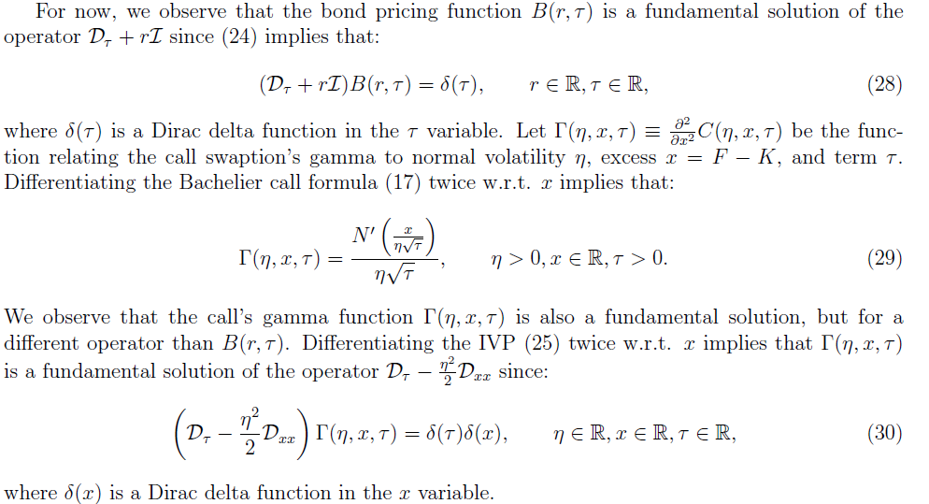
Conclusion
Benchmark Models

Slide 10
Conclusion
Benchmark Models
Besides being fundamental solutions, the two functions $Β$ and $Γ$ each arise in the Rodrigues
formula and inner product for Laguerre polynomials and for the probabilists' Hermite polynomials.
Not quite understood.

Slide 11
Conclusion
Market Models
In this section, the author described two additional models. A market model of stochastic yields is used to build an arbitrage-free yield curve. Analogously, a market model of stochastic implied volatilities
is used to build an arbitrage-free volatility smile. He also drew an analogy between these two models.
1. Market model for yields
Suppose that under Q, the risk-neutral yield dynamics are given by the solution to the following stochastic differential equation (SDE):
The absence of arbitrage implies that at each time t, each bond's price grows in expectation at
the short rate rt. As a result, we obtain the following no arbitrage constraint on yields:

Slide 12
Conclusion
Market Models
We have the following three Greeks:
Then a specification of the risk-neutral drift and difusion processes governing yields determines an arbitrage-free yield curve.

Slide 13
Conclusion
Market Models
2. Market Model for Implied Volatility
Suppose that under $Q^{a}$, the forward swap rate process F solves the following stochastic differential equation (SDE):
To compensate for the absence of a speficication of the instantaneous normal variance rate V ,
we suppose that under $Q^{a}$, the implied volatility process $η_{t}^{2}(m)$ is the solution to the following
stochastic differential equation (SDE):
Let $ρ_{t}ε[−1,1]$ be the bounded stochastic process governing the correlation between the two standard Brownian motions W and Z at time t.
The absence of arbitrage implies that at each time t, each swaption's price is a local martingale.

Slide 14
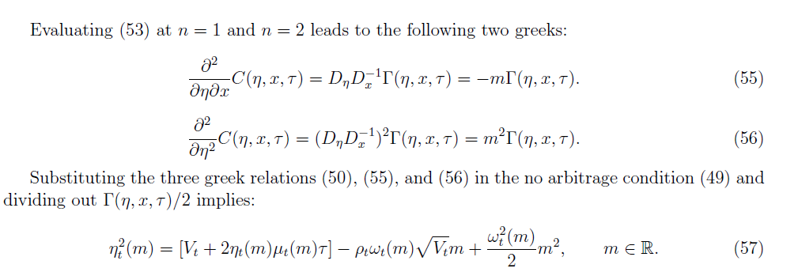
Market Models

Slide 15
Market Models
3. Comparing Market Models

Slide 16
Conclusion
Overview
1
2 Benchmark models.
Connection of yield and implied volatility under these models.
2
1
2 Market models.
2
Connection of yield and implied volatility under these models.

Slide 17
Summary
In this paper, the author found particular measures of implied volatility and moneyness of a European
swaption, so that the resulting volatility smile is analogous to the yield curve for zero coupon bonds.
The relation was used to develop arbitrage-free curves in both cases.
Extensions
Notation
Market support e.g. yields and implied vol not parallel shift, coupon bonds
Bachelier model vs Black model

Slide 18
Thank You!

